Slide 1
Week 4 Attendees
Completed All Assignments
5 Seasoned Expired Prospects
Keep on Coming Back…
Becoming a LISTING AGENT is not easy!!
It might be easy to get a friend or family member to list with you but if you want to build a large inventory…
It takes WORK!!

Slide 2

Take 10 Listings
Learn to List
Solicitation
Unique Selling Propositions
Objection Handling
Meet New People
Social Media
Telephone/Door knock
Bold Leads other services
Present & Follow Up
Bullet Proof Listing Presentation
The Digital Marketing Strategy
Customer Relationship Management
Farming niche’ or neighborhood
Creating Urgency
Closing Techniques

Slide 3
R.O.I.
Credibility
Signage
Syndication
Multi-Transaction
Buyers
Take 10 Listings

Slide 4

Take 10
Take 10 Listings by upgrading skills & managing tasks with coaching & accountability

Slide 5
Live Telephone ~ Voice Mail ~ SLY DIAL ~ Text ~ Facebook Message ~ VIDEO e-Mail
Good Morning…
My name is ABC 123, I was one of the agents that tried to sell your house this past summer, when you were on the market with ABC XYZ Real Estate.
I ended up selling another home and I am sorry it didn’t work out.
The reason I am calling is that this time of year is ACTUALLY the hottest time to sell your house, the kids are going to be out of school soon and the interest rates are still incredibly low (which is attractive for all of us)!!!
Can I ask you “IF THE PRICE WERE RIGHT ( I mean really right) would you consider making a move between now and August 2019???
If you could let me know your dream destination and your perfect scenario, I mean if you had a magic wand where would you spend the next chapter of your life… I would love to get working on that as well.
Your house may be worth more than you think!!!

Slide 6

Take 10
Take 10
Source
of Business
Charting
Take 10
Take 10

Slide 7
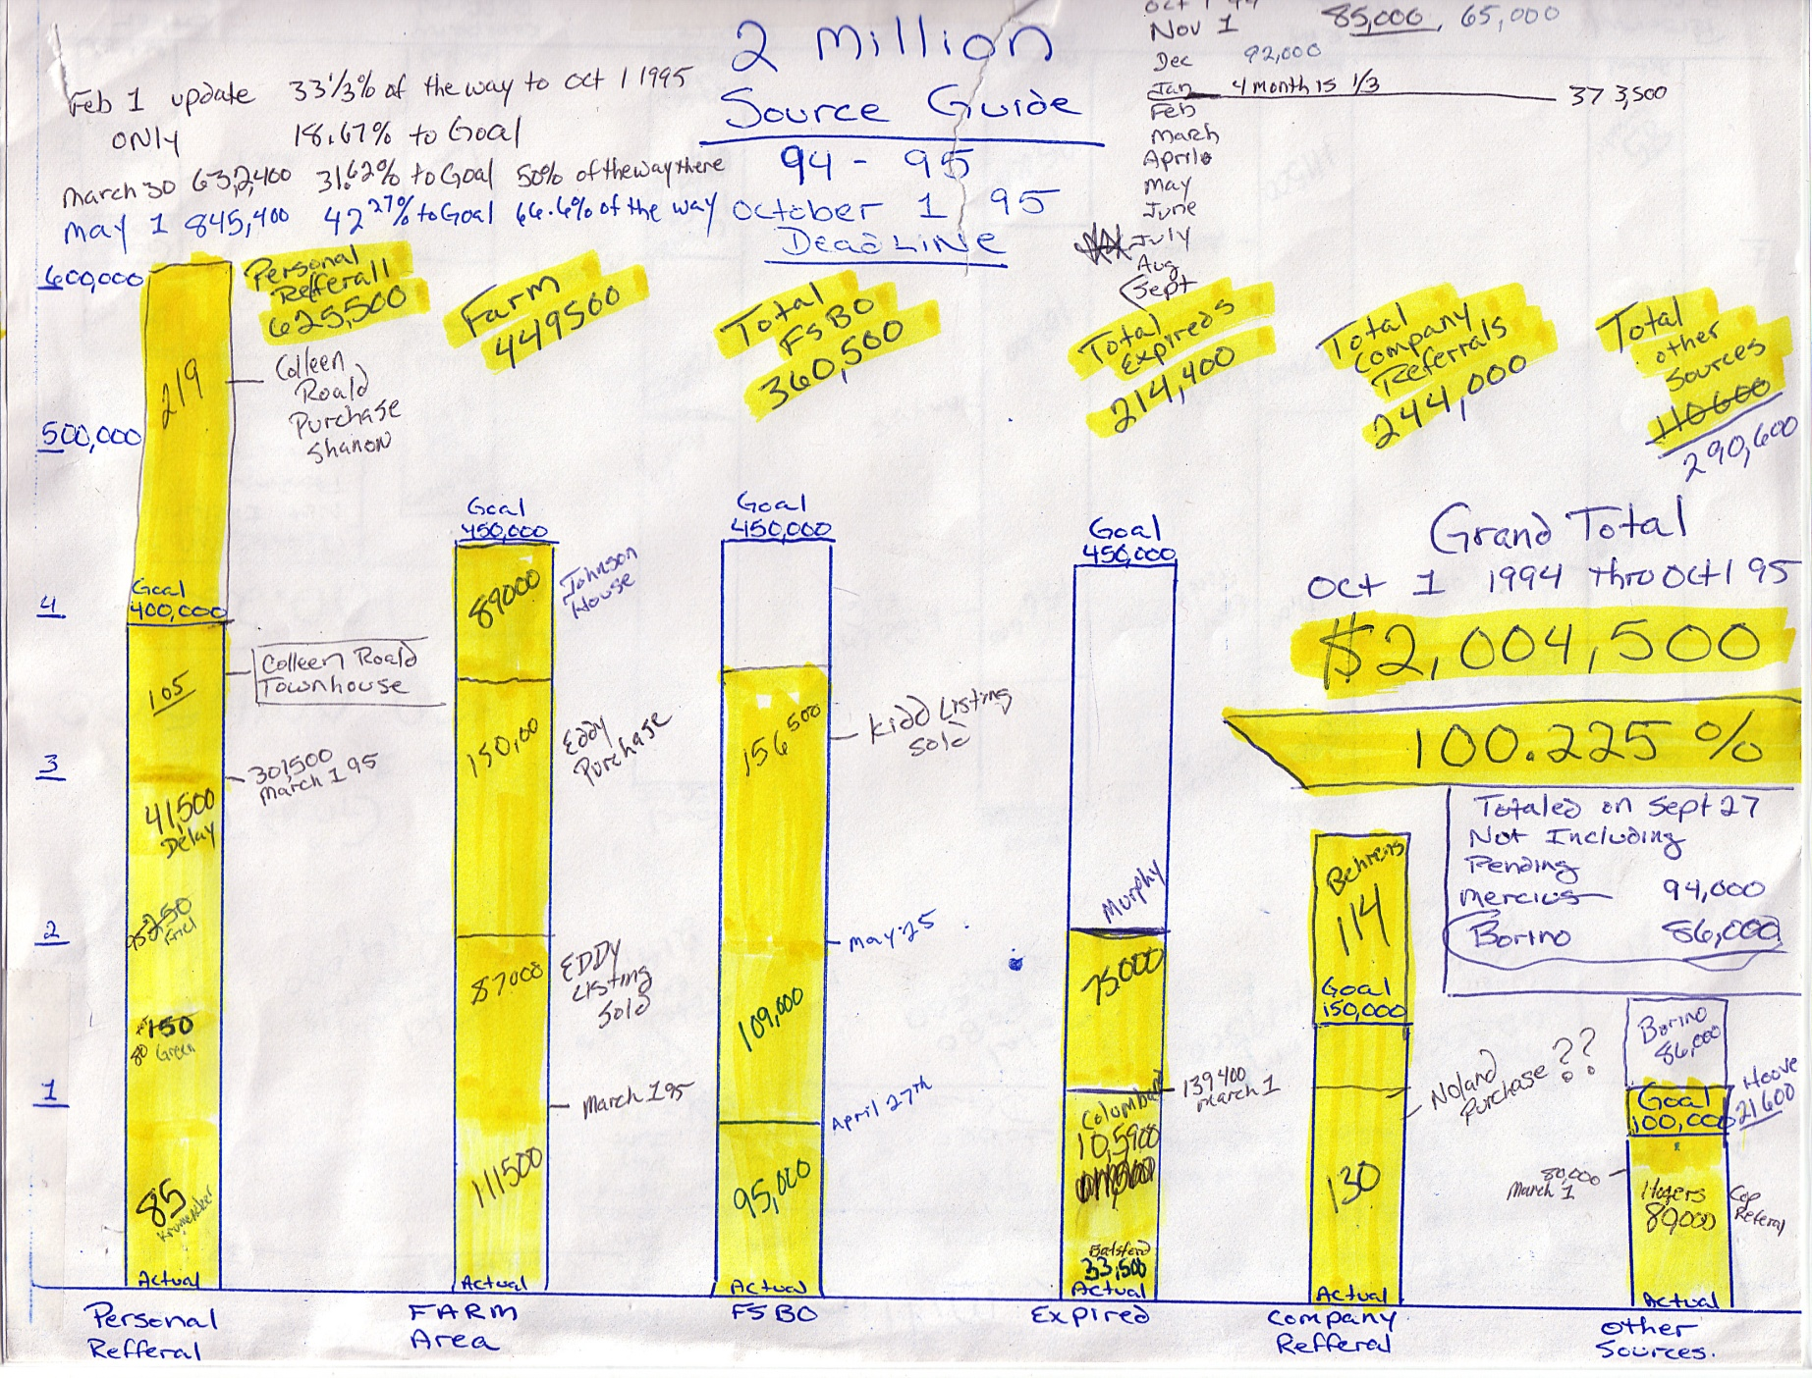

Slide 8
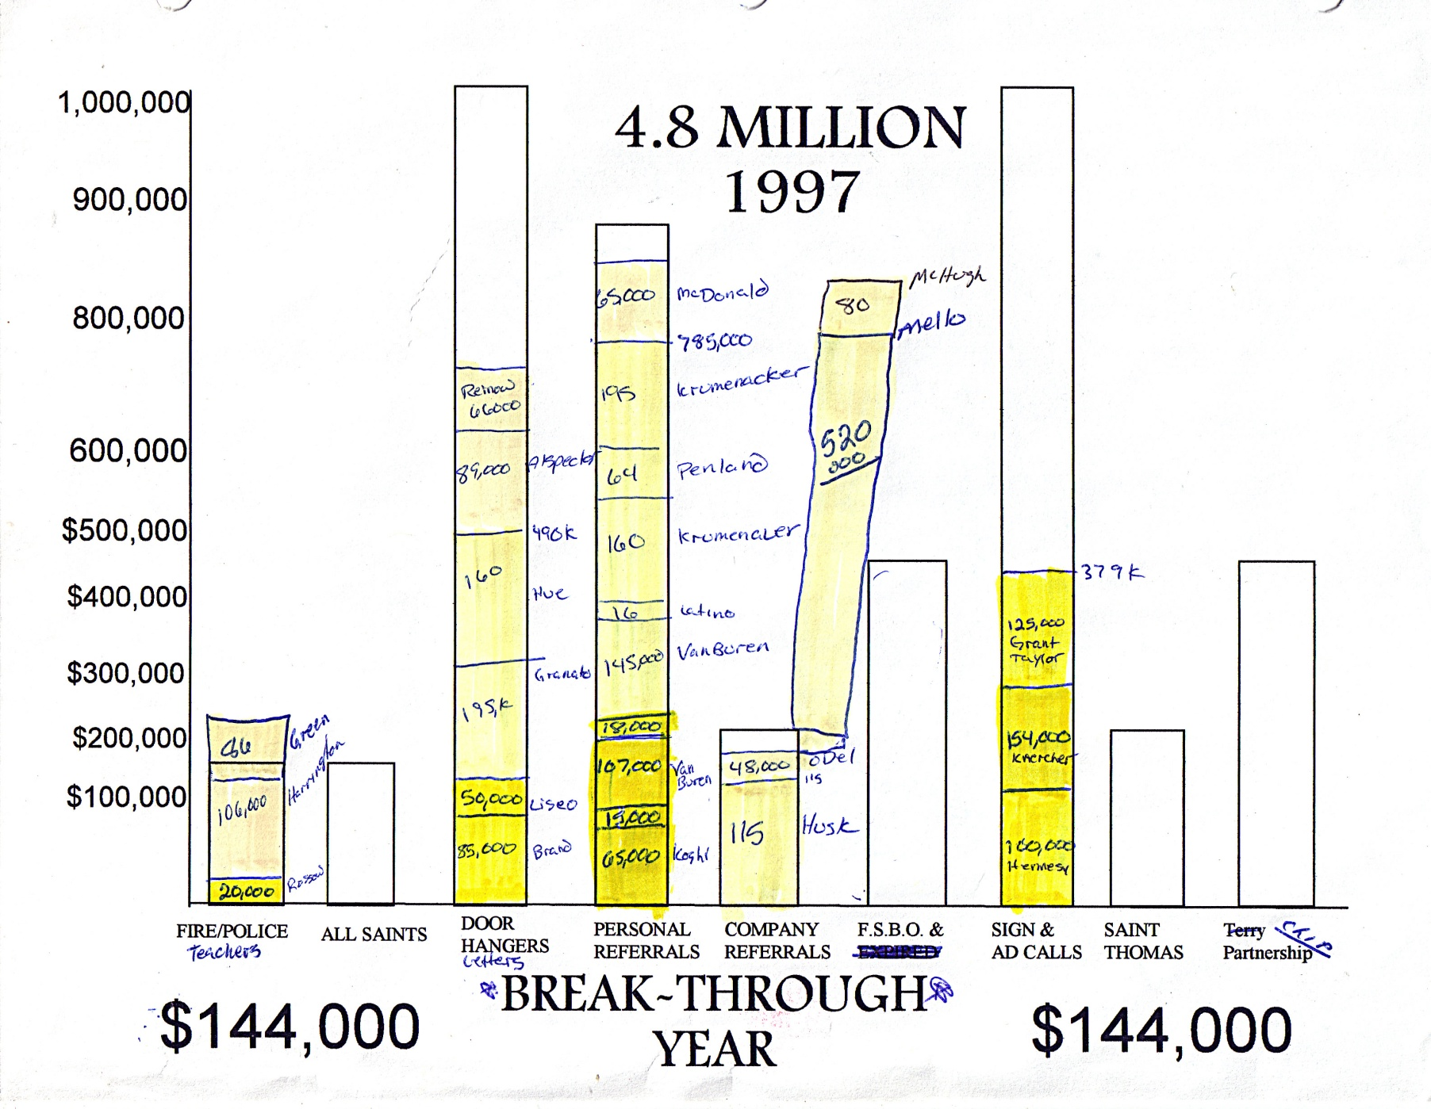

Slide 9
Source of Business Charting
Manage Expectations
Set a Firm Projection
Balance Income vs. Expenses
Example from Week 3 Assignment”: Seasoned Expired
Just 5 Seasoned Expired Listing Per Week
That would be 200 Seasoned Expired in 40 Weeks
20 Conversations - 8 Listing Appointments – 4 Listings
60 Minutes Per Week for 40 Weeks

Slide 10
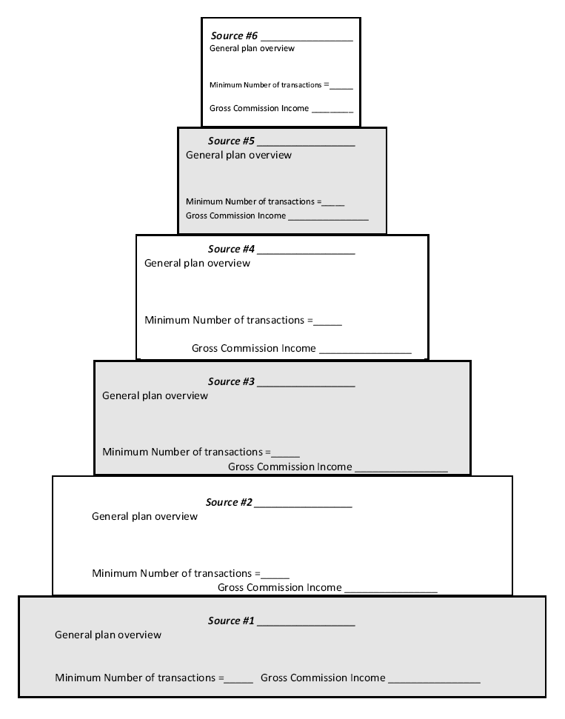
FSBOs
It’s much easier to List
3 Houses from
4 PROVEN SOURCES
Than it is to “just list”
12 Houses.
BOLD Leads
Seasoned Expired
Niche’ Farm
Absentee Owners
Friends & Family

Slide 11


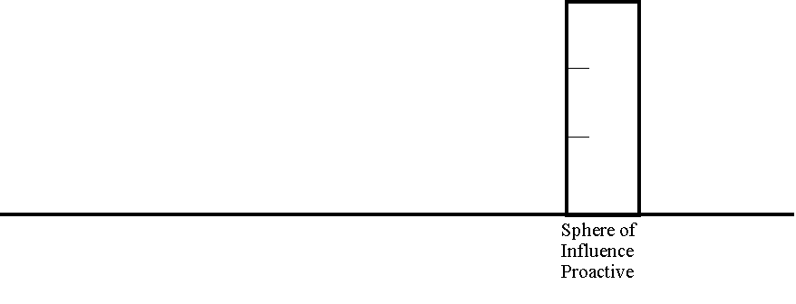
If you managed and marketed to database of
    Friends
    Family
    Coworkers
    Alumni
    Neighbors
    Acquaintances
    Vendors
    PTA
    Shop owners
    Sports Contacts
Do you think you could sell 3???
3 x $133,333 @ $4000
1 Hour
Each Week
Marketing

Slide 12

If you farmed a SUBDIVISION of 600-1200 homes
    Door hangers (free)
    Newsletters (free)
    Postcards
    Letters
    Surveys (free)
    Emails (free)
    Social Media (free)
    Website (free)
Do you think you could sell 3???
3 x $133,333 @ $4000
2 Hours
Each Week
Farming

Slide 13
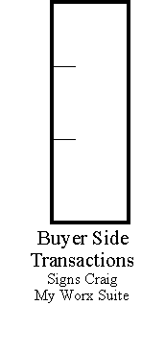
3 Hours
Each Week
Marketing
Buyers
If you marketed for Buyers
    Facebook Marketplace
    Craig’s List (free)
      Post HUD
      Post New Const.
      Post Auction.com
    Sit Open Houses (free)
      Ask listing Agent
      Ask FSBO
      Hud Homes
      Small Builder
    Load My Worx Suite Up
Do you think you could sell 3???
3 x $133,333 @ $4000

Slide 14
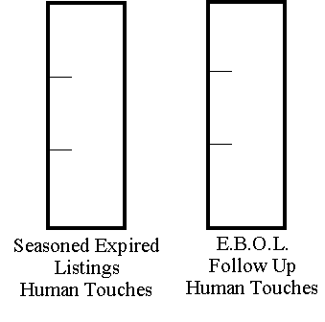
4 Hours
Each Week
Warm Human
Contact
Warm Human Touches
    Facebook Friend
    LinkedIn Affiliate
    Find and Email Address
    Text
    Drop off a package or a note
Dare I even suggest or say that you would
    Drive over and say “hi”
    Text and note or observation
    Telephone for a specific reason
Do you think you could sell 3???
3 x $133,333 @ $4000

Slide 15
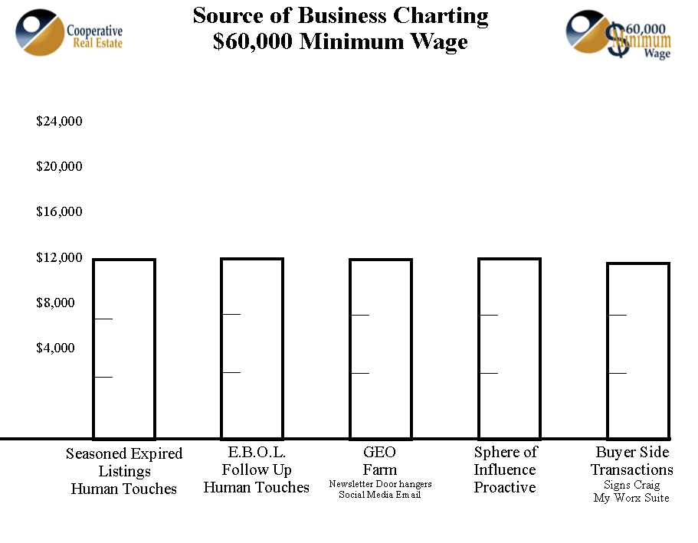
4 Hours
2 Hours
1
Hour
3 Hours
This is the plan!!!
10 Hours per Week of Work

Slide 16
Fast forward and you sold a $325,000 @ $9100

Slide 17
Fast forward and you sold a $325,000 @ $9100
You closed a home in your FARM for $250,000 @ $7500

Slide 18
Fast forward and you sold a $325,000 @ $9100
You closed a home in your FARM for $250,000 @ $7500
Your sisters brothers friend bought a condo for $150,000 @ $4500

Slide 19
Take 10 Listings
Learn to List
Solicitation
Unique Selling Propositions
Objection Handling
Meet New People
Social Media
Telephone/Door knock
Bold Leads other services
Present & Follow Up
Bullet Proof Listing Presentation
The Digital Marketing Strategy
Customer Relationship Management
Farming niche’ or neighborhood
Creating Urgency
Closing Techniques

Slide 20

Presentation Skills
An Elite Listing Agent Pricing Matrix
An Elite Listing Agent Commission Matrix
How to get 6%
every time!

Slide 21
$240k
$234,900
$229,900
$219,900
If you told me you had to be out by
Agent Name
Agent Contact

Slide 22
$240k
I believe in FIRM pricing in this market!!
When an offer comes in…
It is much easier to get a buyer up!!!
P.I.T.I.
Let me counter everyone firm at $229,900
Rather than sit 2-3 months at $234
We will both be happier if we turned down offers than if we don’t have any offers!
$234,900
$229,900
$219,900
If you told me you had to be out by
Agent Name
Agent Contact

Slide 23
Warning: Commission Arrangements must be approved by your Broker
These are examples of Unique Selling Propositions which are not applicable
for all Listing Prospects.
Every Seller is different
Every Listing carries different motivation and scenarios
Sales is an art not a science therefore the “Listing Agent”
must be adept at utilizing the right proposition for the right
SELLER!
In the event of a highly competitive bidding situation
with a FSBO mentality or a multiple transaction opportunity
This is my full court press… pulling out THE BIG GUNS!!!

Slide 24
I want to talk to you about how YOUR REAL ESTATE COMPANY is making
Real Estate Commission much more friendly and win/win for the families we serve!
6%
Offering 3% to mobilize the entire
Real Estate Community and Worldwide Network
5%
Upgrade or Empty Nester Discount
Bundle your next transaction and save 1%
4.75%
I will race the MLS & Worldwide Web
If I sell the home without a cooperating agent.
3.75%
If I sell your home myself & you purchase
your next home from me.
1%
If at anytime that your home is listed
you find a buyer through your own efforts

Slide 25
I want to talk to you about how YOUR REAL ESTATE COMPANY is making
Real Estate Commission much more friendly and win/win for the families we serve!
6%
Offering 3% to mobilize the entire
Real Estate Community and Worldwide Network
5%
Upgrade or Empty Nester Discount
Bundle your next transaction and save 1%
4.75%
I will race the MLS & Worldwide Web
If I sell the home without a cooperating agent.
3.75%
If I sell your home myself & you purchase
your next home from me.
1%
If at anytime that your home is listed
you find a buyer through your own efforts

Slide 26
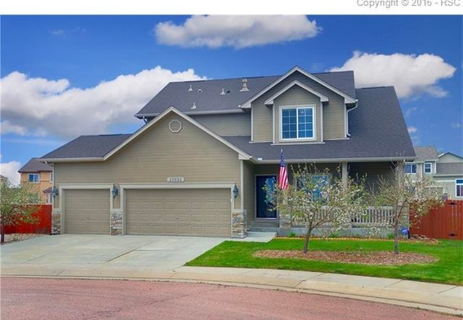
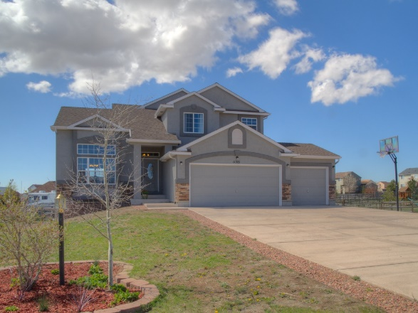
Your Logo Here
$329,900 4/3
$65,807
$350,000 purchase
$12,250 down
$10,500 cc
FHA Loan $836.03
Mo. Taxes $258.00
Mo. Ins $250.00
$1344.03
$229,900
$150,000
$1603
$43k
$13,794
$495
$166,392
$63,508
$65,807
$66,382
$68,681
$349,900 5/4

Slide 27

Presentation Skills
An Elite Listing Agent Pricing Matrix
An Elite Listing Agent Commission Matrix
How to get 6%
every time!
Your Logo Here

Slide 28
If you wish to continue to Week 5
Submit your final Source of Business Chart
ROLE PLAY with 3 different people
your own version of
Pricing & Commission Presentation
Send me an email of how it went!!!
russ@anniemacworx.com

Slide 29
Take 10 Listings
Guaranteed
Learn to List
Solicitation
Unique Selling Propositions
Objection Handling
Meet New People
Social Media
Telephone/Door knock
Bold Leads other services
Present & Follow Up
Bullet Proof Listing Presentation
The Digital Marketing Strategy
Customer Relationship Management
Farming niche’ or neighborhood
Creating Urgency
Closing Techniques

