Slide 1
Take 10 Listings Guaranteed
Learn to List
Solicitation
Unique Selling Propositions
Objection Handling
Meet New People
Social Media
Telephone/Door knock
Bold Leads other services
Present & Follow Up
Bullet Proof Listing Presentation
The Digital Marketing Strategy
Customer Relationship Management
Farming niche’ or neighborhood
Creating Urgency
Closing Techniques

Slide 2
R.O.I.
Credibility
Signage
Syndication
Multi-Transaction
Buyers
Take 10 Listings Guaranteed

Slide 3
Take 10 Listings Guaranteed
10 Listings @ $250,000 = $75,000
2 Sellers Upgrade @ $300,000 = $18,000
2 Sellers Referred Out @ 25% = $4,000
2 Buyers from Inquiries @ $250,000 = $15,000
$112,000
What would your life be like?

Slide 4
Take 10 Listings Guaranteed
10 Listings @ $325,000 = $97,500
2 Sellers Upgrade @ $400,000 = $24,000
2 Sellers Referred Out @ 25% = $6,000
2 Buyers from Inquiries @ $325,000 = $19,500
$147,000
What would your life be like?

Slide 5
Take 10 Listings Guaranteed
10 Listings @ $450,000 = $135,000
2 Sellers Upgrade @ $500,000 = $30,000
2 Sellers Referred Out @ 25% = $8,000
2 Buyers from Inquiries @ $450,000 = $27,000
$200,000
What would your life be like?

Slide 6
Take 10
Take 10 Listings by upgrading skills & managing tasks with coaching & accountability

Slide 7
Week One Assignment
“I am a seller”
Study your Telemarketing Worx Agenda
Devise 60-120 second message
Dial my phone
What do you want me to know?

Slide 8
Week One Assignment
Send me a note...
“I am a seller”
Study your Telemarketing Worx Agenda
Devise a message ~ Why should I call you?
What do you want me to know?

Slide 9
Week One Assignment
Send me an email:
“I am a seller”
Study your Telemarketing Worx Agenda
Devise a message ~ Why should I call you?
coaching@anniemacworx.com
What do you want me to know?

Slide 10
Week One Assignment
Send me a message: “I am a seller”
Study your Telemarketing Worx Agenda
Devise a message ~ Why should I call you?
Find me on Facebook or Linkedin
What do you want me to know?

Slide 11
Solicitation Channels
Seller
Call
Mail
Email
Social Media
Text
Stop By

Slide 14
Week One Assignment
Watch 2 brief videos at www.anniemacworx.com OnDemand Library
Highlight what jumps out at YOU
Send notes to me coaching@anniemacworx.com

Slide 15
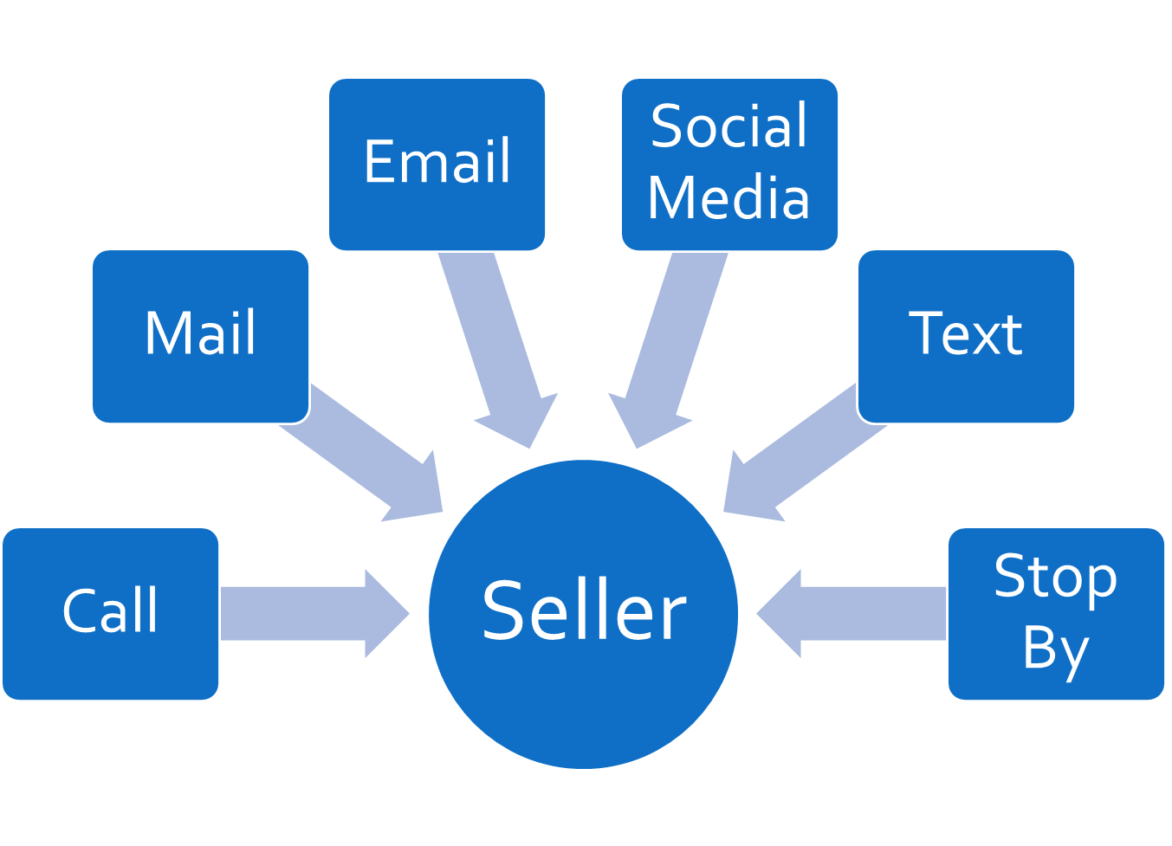
Success in Residential Real Estate is created when YOU do the things tat no one else is willing to do for a few years…
Then you get to do what no one else gets to do for the
rest of your life.
Written Goals and Plans to Achieve Them
Complete your Coaching Assignments
“when you don’t want to”
Master all 6 Channels of Solicitation
Farm an Area “every month” for 36 Months
Do 2 Open Houses every Month for 36 Months
Ask your Broker if you can call the old leads
Post Auction.com Hud.gov properties to Craig’s List, Ebay Classified and Facebook Marketplace
(10 x per week for 150 Weeks)
Go to 36 BNI Meetings before you quit
Market to First Responders/Veterans for 3 years

Slide 16
Week TWO Lesson…
I am a SELLER of $700,000 home….
I am responding to your email, letter, voice mail AND…
I ask you one questions before I decide if I want you to come over to my house.
What is your commission?
What do you want me to know?

Slide 17
Week TWO Lesson…
I am a SELLER of $700,000 home….
I am responding to your email, letter, voice mail AND…
I ask you one questions before I decide if I want you to come over to my house.
How much is my house worth?
What do you want me to know?

Slide 18
Take 10 Listings Guaranteed
Learn to List
Solicitation
Unique Selling Propositions
Objection Handling
Meet New People
Social Media
Telephone/Door knock
Bold Leads other services
Present & Follow Up
Bullet Proof Listing Presentation
The Digital Marketing Strategy
Customer Relationship Management
Farming niche’ or neighborhood
Creating Urgency
Closing Techniques

