Slide 1
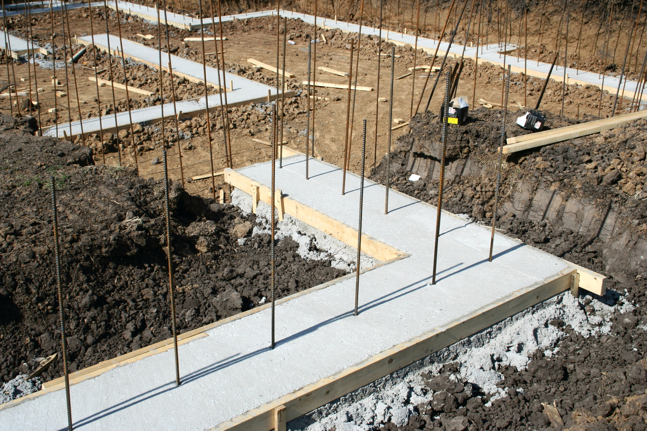

Week 1
How To Pick and
Work Your Farm
DOES YOUR REAL ESTATE CAREER HAVE A FOUNDATION?
Notes:
Welcome to Farming Fridays introduction sponsored by AnnieMac Home Mortgage
Lets give a couple of our student an extra moment to get seated and you may be interested in taking some notes
Lets also take a moment and thank our Mortgage Partners in the room for putting this National Lunch and Learn League together.
I think its just awesome what AnnieMac has done, I think we have more than 200 offices and over 1000 Agents attending todays program.
No pressure right???? But seriously I bet you walk away with some good value today and you are going to be invited to a 6 week COACHING PROGRAM that is also sponsored entirely by AnnieMac Home Mortgage.
But my goal today is that even if you elect not to take the FREE 6 week Coaching Program that you take away several income generators from todays session.

Slide 2
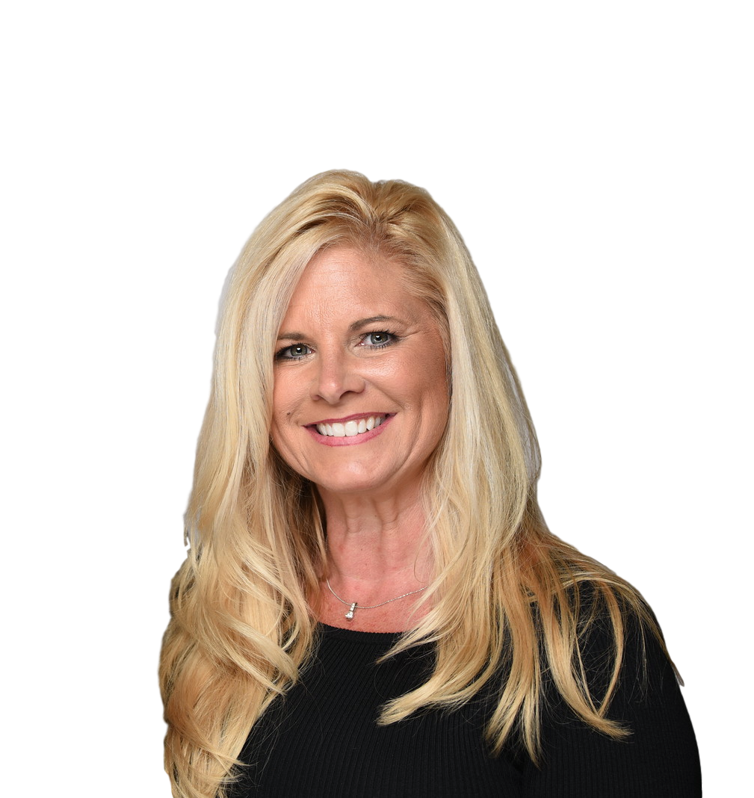
Kerry Fitzpatrick
Bachelors Degree Education
Masters Degree Administration
30 years in Residential Real Estate
10 years Administration
10 Years Teaching REALTORS®
Notes:
My name is Kerry Fitzpatrick
I am one of the lucky founders of the AnnieMac Worx Productivity Platform and The My Worx Suite Technology Solution for Realtors
The reason I say I am lucky is that thanks to the AnnieMac Home Mortgage Professional in the room with you, I never have to sell anything or charge our students any money whatsoever. We have 61 training modules with 14 different instructors all operating with no charge to our Real Estate members.
We also have this incredible digital marketing system that could cost $1500 per month per Brokerage but it is also completely free from any charge because of AnnieMac
But I want you to know I was a new agent… a long time ago and the first thing I ever did was farm… Russ and Chip and my Sales Manager taught me early and often of the power of Specialization … SPEICALIZING in a neighborhood and because of some good training I was able to double my teaching salary in my first year and grew a nice income before I out earned my husband who was making SIX FIGURES!!!
SO this message is very personal to me.

Slide 3

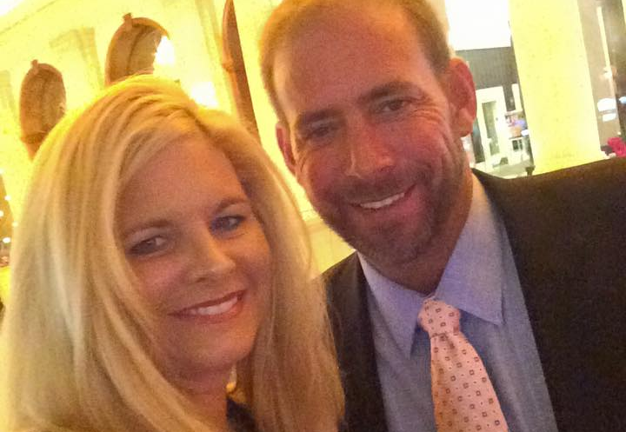
In Memory and Appreciation
Joseph “Chip” Isabella
In Memory and Appreciation
Joseph “Chip” Isabella

Slide 4

$18,000
$0.00…..
…..$39,999
$40,000
$60,000
$100K
$250K –
2 Million
Notes:
LOOK AT THE BIG BUBBLE ON THE LEFT SIDE OF YOUR SCRREN: 79% of the Realtors out there earn under $40,000 in gross commission income AND the median income of that group was $18,000 ,,, we thought that was pretty sad… TODAY we talk to brokers in March and 70% of their Agents haven’t sold a home yet for the whole year, one quarter of the year and no sale… We meet agents every day that sell 4-6 homes a year!!! For a whole year!!!
you’re talking about minimum wage type numbers to that of an assistant manager at a dollar store in residential real estate if your one of that level earners in this class today.
I have good news: you don’t need a boss to come give you a raise you don’t need a review
this this job will pay you what you ask you just need to ask it the right questions and do the right work and your income is unlimited.
$300,000 $500,000, it’s just a matter of putting that commitment in there and I think that’s where there’s a separation and a lot of agents with their income.
So if you’re one of those folks on here and earn under $40,000 you’ll want to take some good notes here things to make that different for you in the coming year.

Slide 5
Slide 3
No Predictable
Recurring Revenue Streams
16%
Had a FARM AREA
9%
$18,000
6 MONTHS
3%
ONE YEAR
$0.00…..
…..$39,999
$40,000
$60,000
$100K
$250K –
2 Million
Notes:
so of the REALTORS we surveyed that were in the lower percentile of earners
ONLY 16% of them said that they had a farm or any area of specialization!!!
they didn’t really say how they worked it, but they had a farm area or specialization
9% reported that they had a farm area for more than six months
And 3% of this group said they had the SAME FARM for more than one year only 3% of the people earning under $40,000
had a farm for more than one year!!!

Slide 6

MORE THAN A YEAR
64%
$18,000
$250K –
2 Million
$0.00…..
…..$39,999
$40,000
$60,000
$100K
Notes:
what was very very compelling for us is that 64% of the agents out that earn over $100,000 in gross commission every year
six figures: all had a farm area for more than a year that they actively worked and pursues

Slide 7
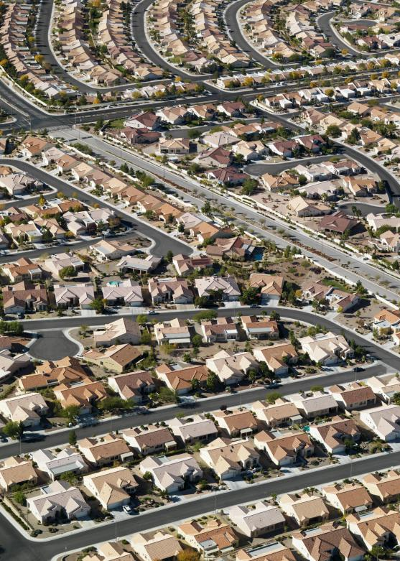




Slide 7
64%
3%
.
Notes:
3% of the agents under $40k
64% of the agents over $100k now we didn’t do the survey but I would be willing to bet the figure jumps to 75-80% of Realtors that make over $200k have a farm area and have had it for more than 1 year….. SUCCESS REALLY DOES LEAVE CLUES!!!
because their the ones having success they are the rain makers out there
and you should look at implementing these systems moving forward.

Slide 8
6 Weeks
Week 1
How To Pick and Work Your Farm
Week 2
Dissecting Your Farming Prospects
Week 3
Build Your Brand Around Neighborhood Culture Using Annual Events
Week 4
In With The Old and In With The New
Week 5
Managing Your Distribution Team
Week 6
Economies of Scale
Notes:
Today I get to invite you to participate in six weeks of training, but I’d like to shift from the word training, and I want you to think about a coach or a very assertive instructor.
Like your music teacher back in the day or maybe you had an acting coach or perhaps you’ve had a voice coach or someone who taught you piano.
And if you remember that coach, they didn’t have the luxury of being positive all the time.
Sometimes they had to assert discipline or even constructive criticism on you to get more out of you then you could get out of yourself.

Slide 9


Select a farm based off good business math, work a farm the way top producing agents do.
Week 1
How to Pick and Work
Your Farm

Slide 10


Week 2
How can we create a true pride of ownership as it relates to your geographic farm area?
Dissecting Your Farming Prospects

Slide 11



Week 3
Are you able to create a social network of the families in your farm area based on their common home ownership, shared interests, and personal similarities?
Build your Brand Around Neighborhood Culture Using Annual Events

Slide 12




Week 4
Don’t abandon old school proven farming techniques but add next gen digital marketing strategies.
In with the Old and
In with the New

Slide 13


Week 5
In order to Dominate a Geographic Farm Area on a Budget you should become creative in the deployment of farming materials including digitally.
Managing Your
Distribution Team

Slide 14


Week 6
Once you master the science of spending Dime(s) to make Dollar(s), you will want to duplicate the process.
Economies of Scale

Slide 15

Set the rules in place to guarantee the success of your Geographic Farm Area Business Plan!

Slide 16


This is a very rare but very dangerous occurrence.
He/She has already paid the price of time and money to dominate this farm area.
Never enter a Geographic Farm Area where one (1) LISTING AGENT closes more than 25% of the Listings in the Geographic Farm.
Steer Clear of Established Dominance

Slide 17

“CONSERVATIVE BUSINESS PLANNING”
Never enter a Geographic Farm Area where one (1) LISTING AGENT Closes more than 25% of the Listings in the Geographic Farm.
Simply take a snapshot of the HISTORICAL DATA and determine the Total LISTING SIDE COMMISSION available.
Then project 10% as your GROSS REVENUE
Never project more than 10% capture
of THE LISTING SIDE COMMISSION
during the first year of your Farm!!!

Slide 18

That’s it!
That’s all the revenue that you have to work with for the first year of Your Geographic Farm Area!
Spend a Dime… Make a Dollar!
Never enter a Geographic Farm Area where one (1) LISTING AGENT Closes more than 25% of the Listings in the Geographic Farm.
Never project more than 10% capture of THE LISTING SIDE
COMMISSION during the first year of your Farm!!!
Never spend MORE THAN 10% of your
Projected Gross Revenue on Farming Activities

Slide 19

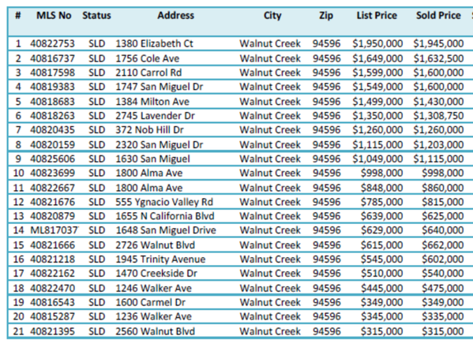
Your First Assignment
Review the most recent 24 months of closings in your “potential” Farm Area.
Inventory the Names of the Listing Agent(s) and calculate if any one (1) Agent is closing more than 25%
25 homes Sold
3 Agent A ~ 10 Agent B ~ 1 Agent C
1 Agent D ~ 4 Agent E ~ 6 Agent F
25 homes Sold
3 Agent A ~ 10 Agent B ~ 1 Agent C
1 Agent D ~ 4 Agent E ~ 6 Agent F

Slide 20
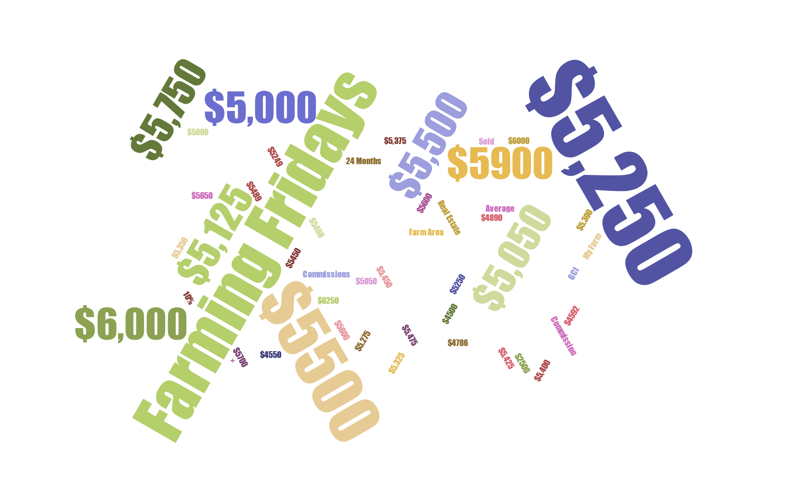

To review the most recent 24 months of closings in your “potential” Farm Area
Calculate the TOTAL LISTING SIDE COMMISSION closed per year!!!
So what is 10%

Slide 21


Finally …
Calculate 10% of the 10% to determine your GROSS OPERATING BUDGET
We need to evaluate the VIABILITY of this Geographic Farm Area from an ECONOMIC Perspective
What’s the budget?

Slide 22
With these 3 Simple Rules
We can project the viability of your farm
We can protect the sustainability of your farm
We can Manage Your Expectations of…
Monthly
Quarterly
Annual Results

Slide 23
Sample Geographic Farm Area: SLEEPY HOLLOW 750 Homes
Average Sale Price $335,000
                2020 24 Sales
2021 21 Sales
2022 29 Sales
Q1 x 4 2023 7 x 4 = 28 Sales
I’m Going to project 26 Sales per year inside of SLEEPY HOLLOW @ $335,000
$8,710,000 total volume per year $522,600 GCI potential $261,300 Listing
$261,300 TOTAL LISTING SIDE COMMISSION POTENTIAL = $26,130 Projected Income
$2613 Marketing Budget Per Year

Slide 24
Sample Geographic Farm Area: FOX RIDGE 900 Homes
Average Sale Price $285,000
                2020 29 Sales
2021 31 Sales
2022 34 Sales
Q1 x 4 2023 9 x 4 = 36 Sales
I’m Going to project 34 Sales per year inside of FOX RIDGE @ $285,000
$9,690,000 total volume per year $581,400 GCI potential $290,700 Listing
$290,700 TOTAL LISTING SIDE COMMISSION POTENTIAL = $29,070 Projected Income
$2907 Marketing Budget Per Year

Slide 25

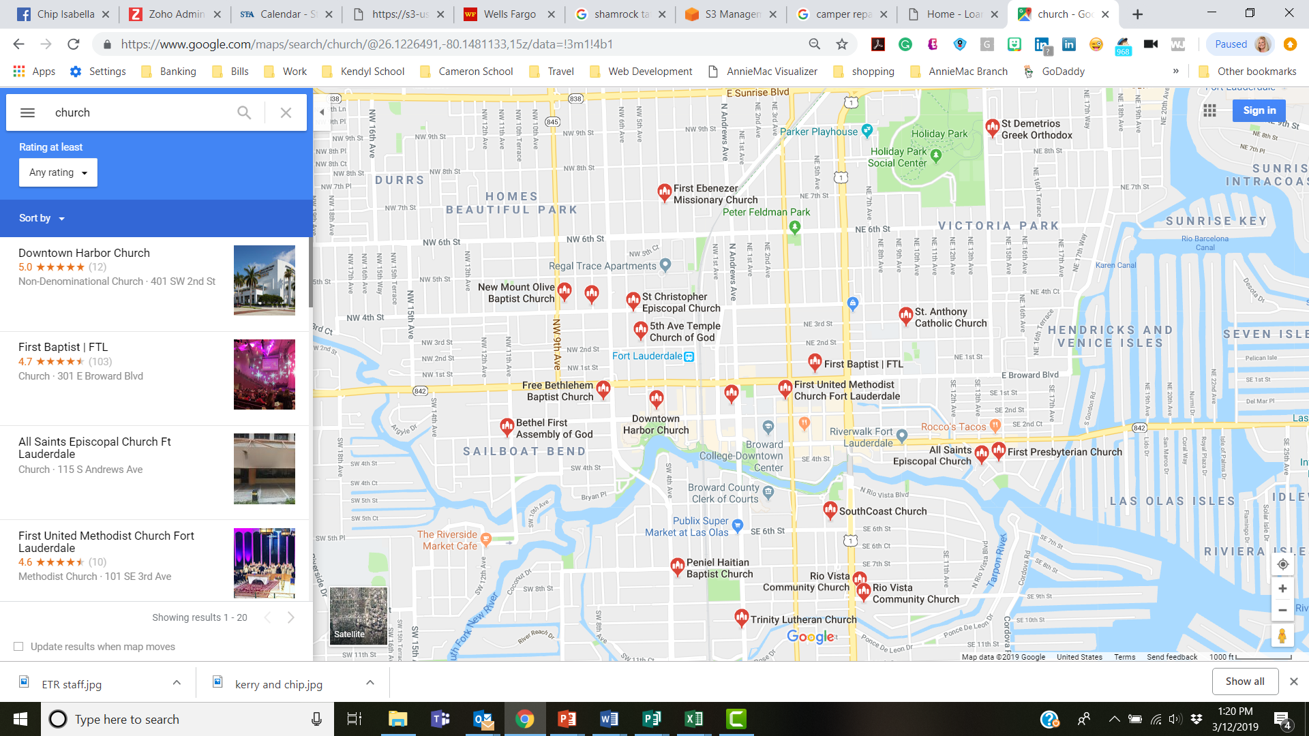
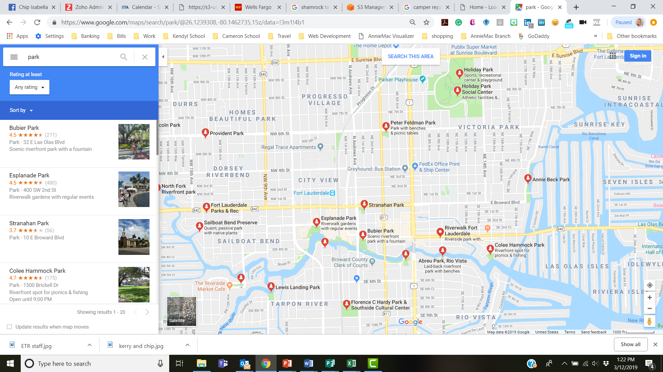

Having all of the information is Key!

Slide 26
Name of Subdivision |  | Number of Homes
Tax Folio Number |  | Public Elementary School
 |  | Public Middle School
 |  | Public High School

Slide 27
The |  | Mall is |  | Miles ~ Google Maps estimates |  | Minutes
The |  | Field is |  | Miles ~ Google Maps estimates |  | Minutes
The |  | Theatre is |  | Miles ~ Google Maps estimates |  | Minutes
Church: |  | is |  | Miles ~ Google Maps estimates |  | Minutes
Church: |  | is |  | Miles ~ Google Maps estimates |  | Minutes
Church: |  | is |  | Miles ~ Google Maps estimates |  | Minutes
Temple: |  | is |  | Miles ~ Google Maps estimates |  | Minutes
Park: |  | is |  | Miles ~ Google Maps estimates |  | Minutes
Park: |  | is |  | Miles ~ Google Maps estimates |  | Minutes
Other Recreation: |  | is |  | Miles ~ Google Maps estimates |  | Minutes
Other Recreation: |  | is |  | Miles ~ Google Maps estimates |  | Minutes
Major Medical: |  | is |  | Miles ~ Google Maps estimates |  | Minutes
Airport: |  | is |  | Miles ~ Google Maps estimates |  | Minutes

Slide 28
Number of Families facing LisPendens #
Number of Families Renting #
Number of Absentee Owners #
Homes purchased in the last 36 months #
Homes purchased 3 to 5 years #
Homes purchased 5-10 years #
Homes purchased 10-15 years #
Homes purchased 15-20 years #
Homes purchased 20 + Years #

Slide 29
Farming Fridays
DOES YOUR REAL ESTATE CAREER HAVE A FOUNDATION?

