Slide 1


Slide 2


Brought to you by…

Slide 3



Your Instructors…
Russ and Kerry Fitzpatrick
AnnieMac Worx
Curriculum Advisor…
Hallie Agostinelli
an Organized Home

Slide 4


Advanced Staging
Beyond RESE
Victoria Guillot, CSS/CRS
“The Stage Coach”
Stage Coach Services LLC

Slide 5
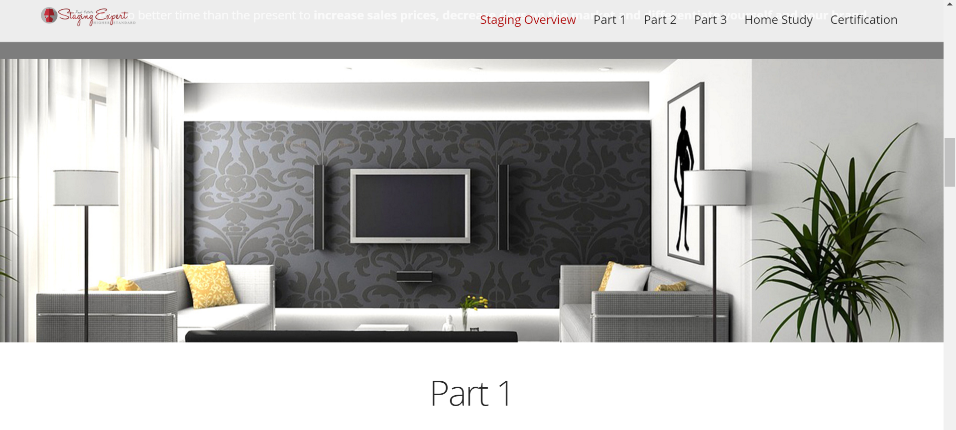

www.reseworx.com

Slide 6





Slide 7

What is the big deal about Staging?

Slide 8
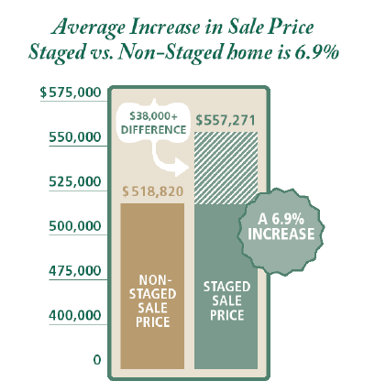

6-13 % Increases in Price
NAR
National Builders Association
HGTV

Slide 9
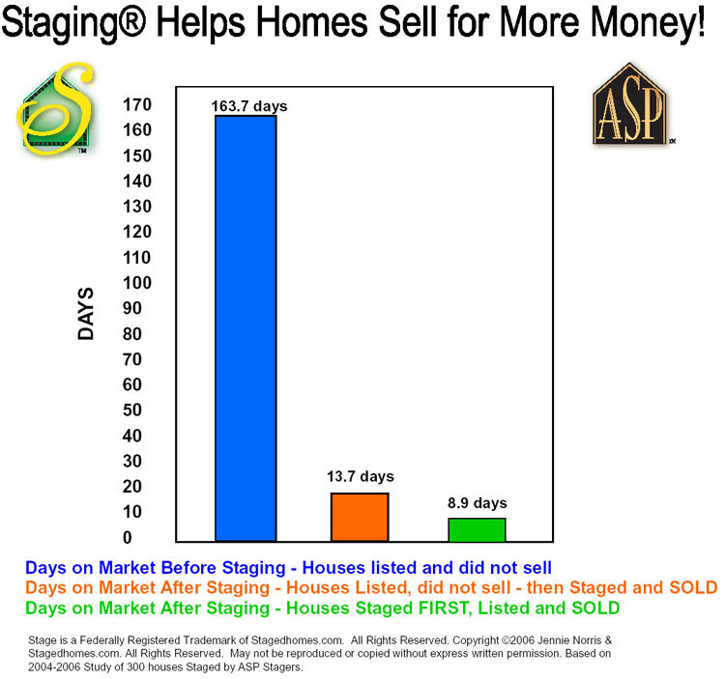
Up to 40% reduction D.O.M
  NAR
  A.S.P.
  National Builders Association
  HGTV

Slide 10
Major Misconceptions of Home Staging
Difficult
Expensive
Rent Furniture
Major Project

Slide 11

 | Improvement | Typical Cost | Increase in Sales Price | Average Return | Agents Who Recommed
Home Staging | Lighten & brighten | $86-110 | $768-935 | 769% | 84%
 | Clean & de-clutter | $305-339 | $2093-2378 | 594% | 91%
 | Landscape & trim | $432-506 | $1594-1839 | 266% | 72%
 | Staging Furniture | $212-1089 | $2275-2841 | 169% | 76%
 | Total | $1035-2044 | $6730-7993 | 478% | 81%
Home Repair | Fix Plumbing – electrical | $338-381 | $992-1208 | 196% | 63%
 | Kitchen Bath upgrades | $1546-21420 | $3823-4665 | 136% | 83%
 | Repair flooring | $1531-1714 | $2267-2589 | 50% | 62%
 | Paint exterior walls | $2188-2381 | $2907-3233 | 34% | 57%
 | Replace carpeting | $2602-2766 | $3585-3900 | 39% | 65%

Slide 12
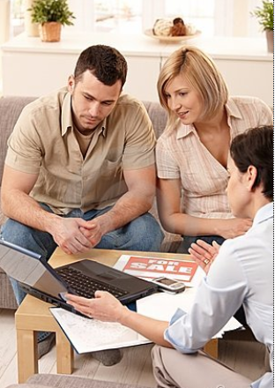



More important than all that…
Can you as a REALTOR get in more living rooms…
Take more listings
Sell more houses as a Real Estate Staging Expert?

Slide 13
Prospect Differently…
Free CMA – How Much is Your Home Worth – Broker’s Price Opinion
Market Data Reports – Neighborhood News – Property Resale Reports
60 Day Sale Guarantee – 30 Day Sale Guarantee
If I can’t sell your home I’ll buy it.
I’ll sell your home in 60 days or less
or I will make the mortgage payment until it’s sold
Move with me and use this truck for free
Highest Price if you can close by “Thanksgiving”, The New Year, April 1, May 30
Free Staging Evaluation
8 page report valued at $600
Absolutely Free and with No obligation
Increase Your Sale Price By 6-13%
Speed up your sale by as much as 40%
Free Staging Service
Call ….
Certified Staging Professional
$600 Pre-listing Evaluation & Analysis
Free of Charge when you call…

Slide 14




Slide 15


Let’s review how YOU can make a difference…
for your clients without spending a lot.
Remember…
Every Photo you see are from
ACTIVE LISTINGS
Above $400,000

Slide 16

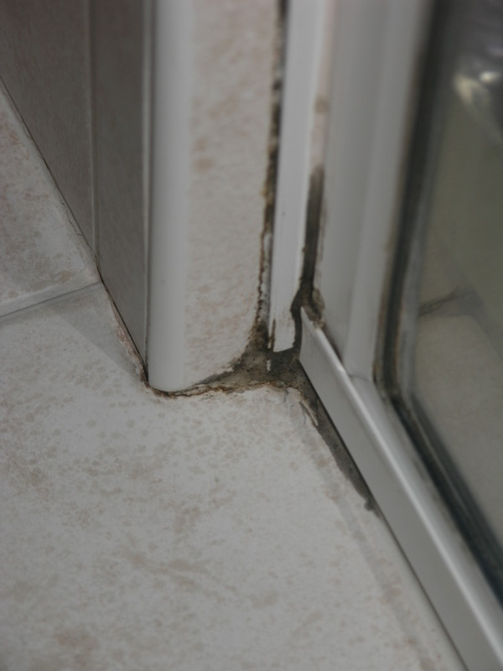
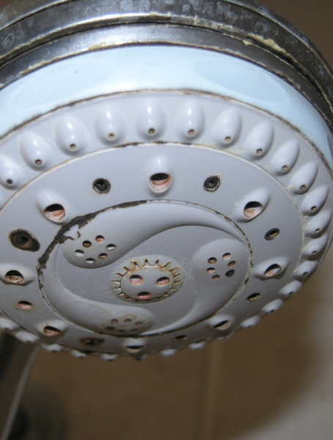

Slide 17
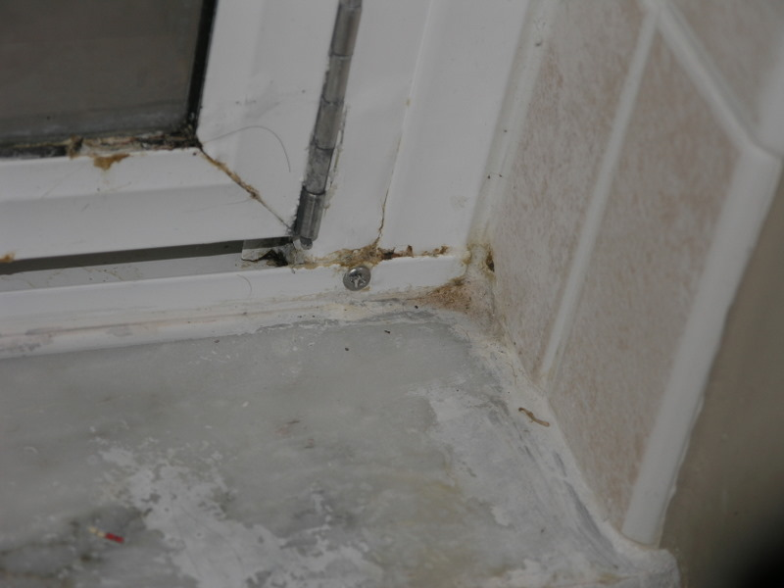

Slide 18
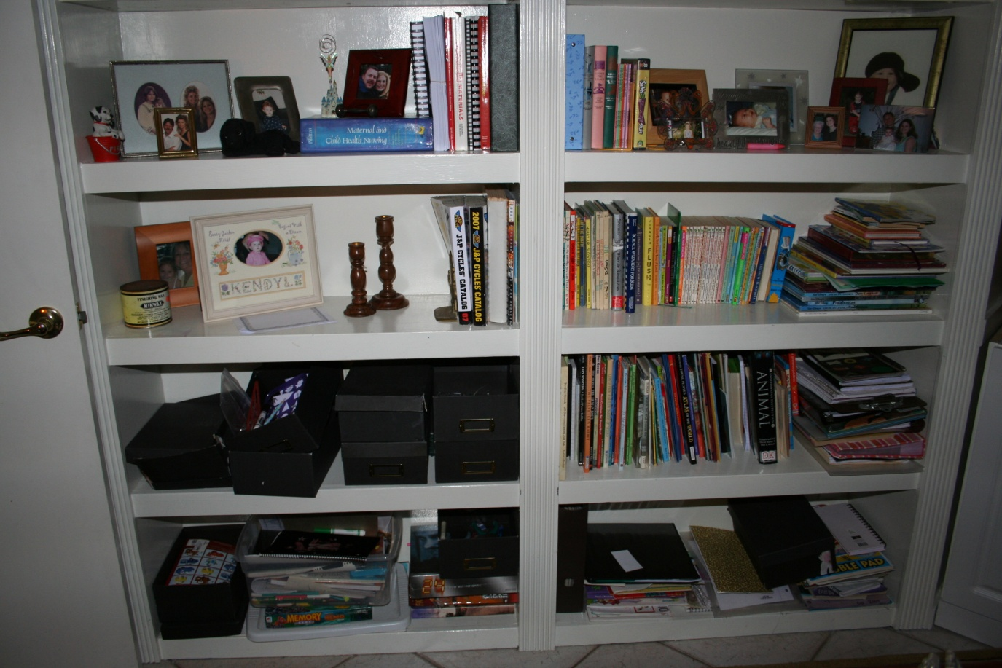

Slide 19
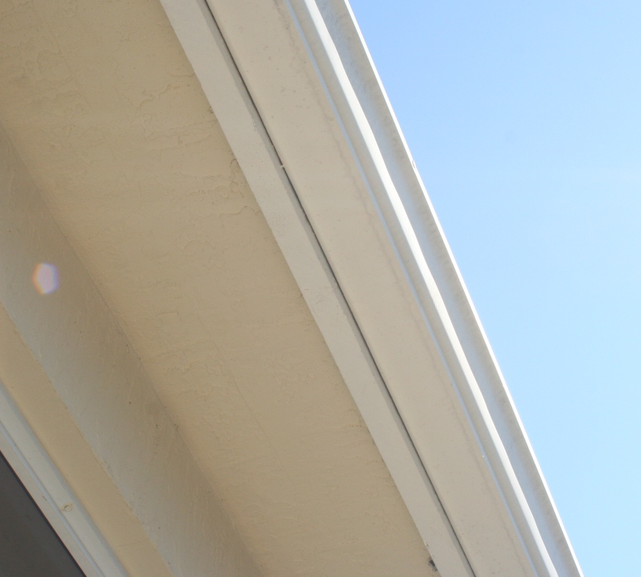
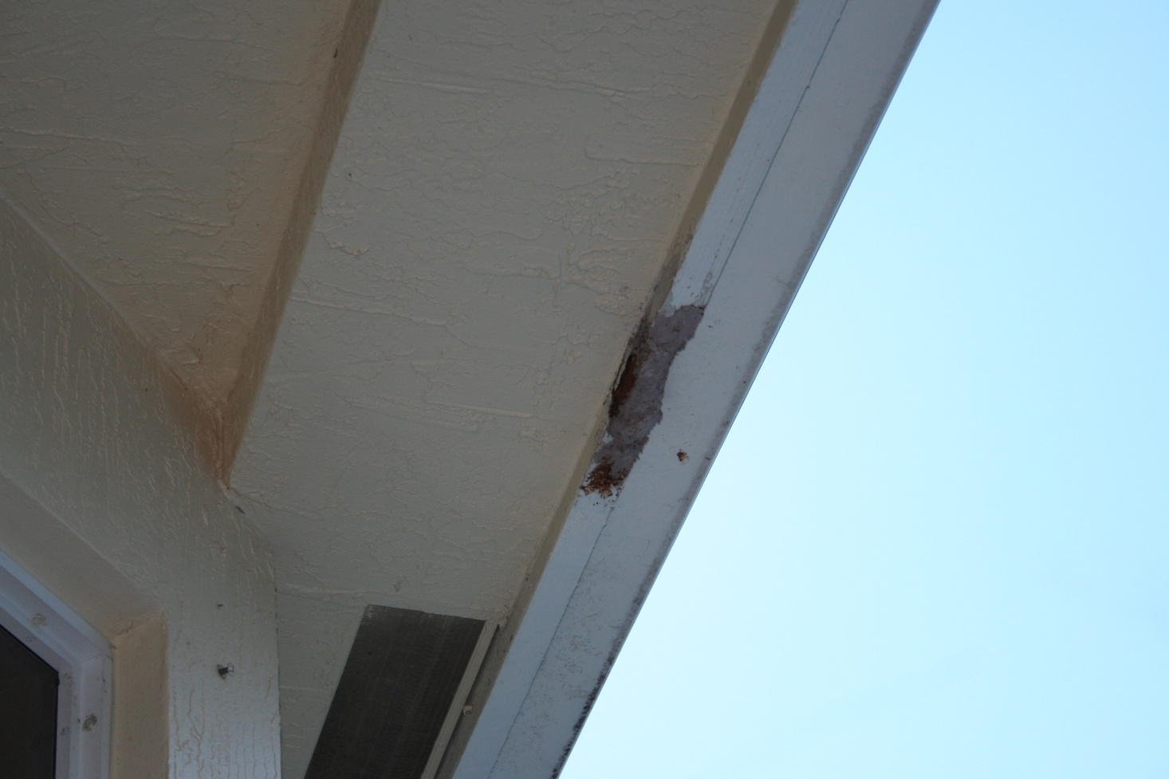

Slide 20
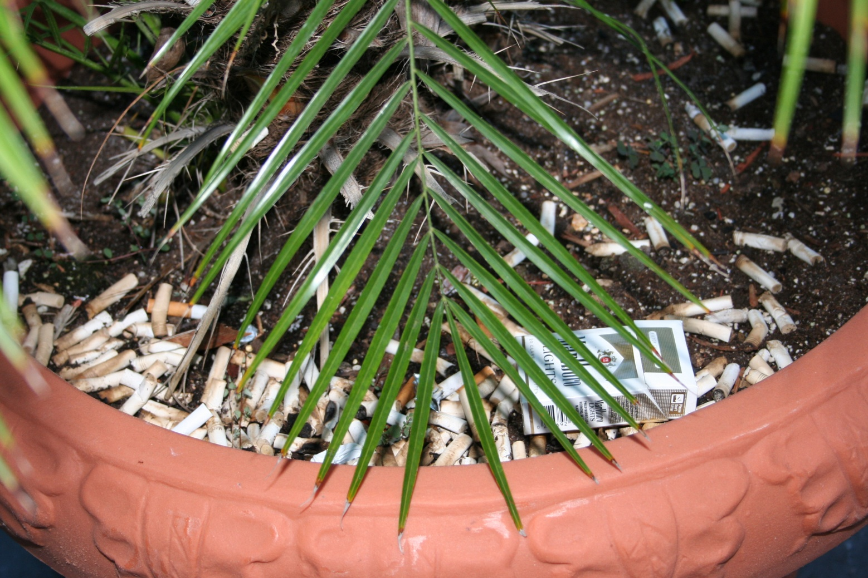
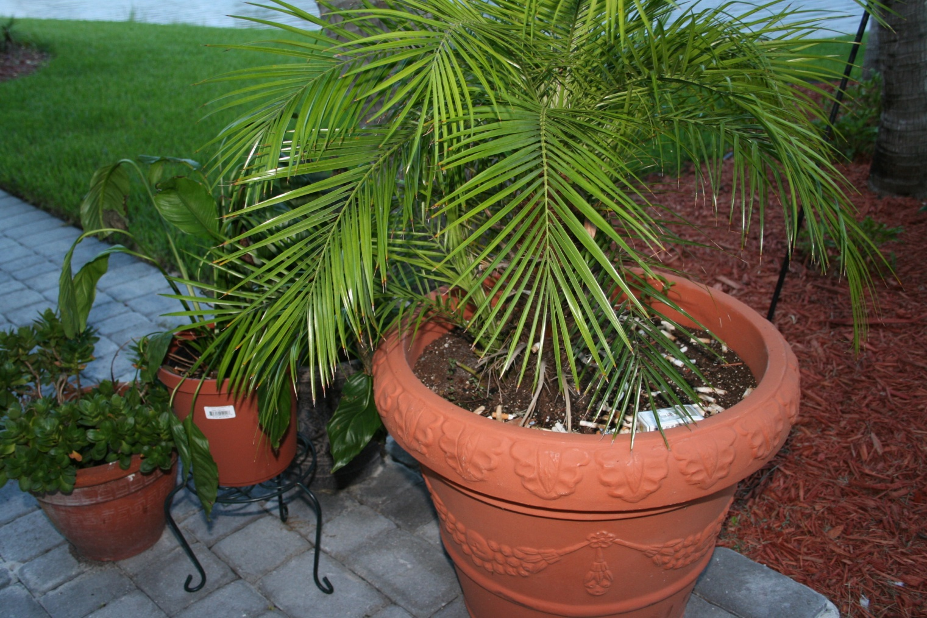

Slide 21
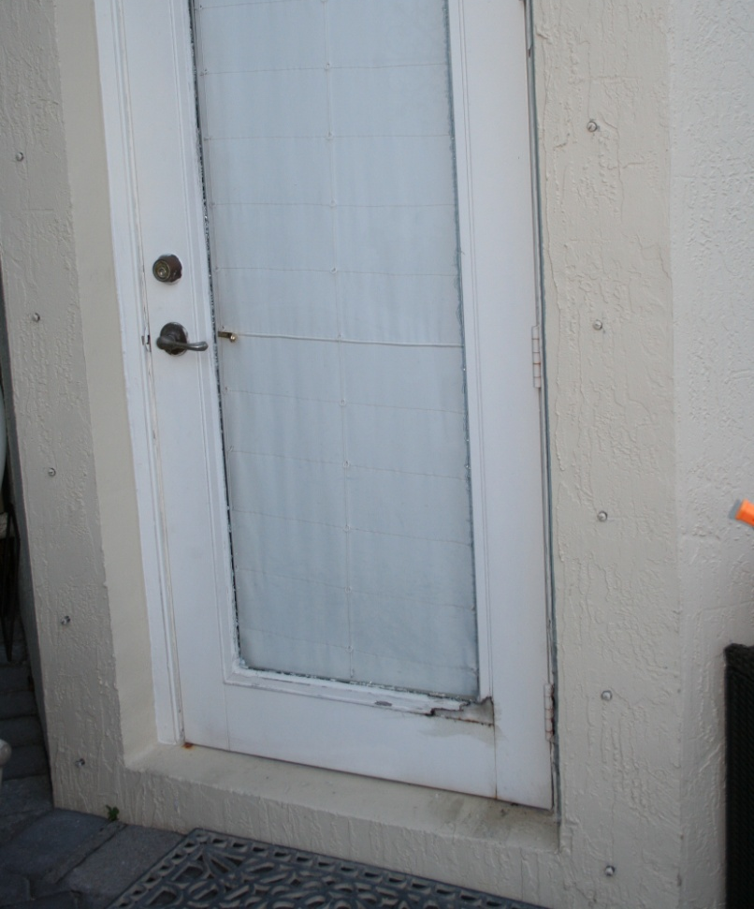
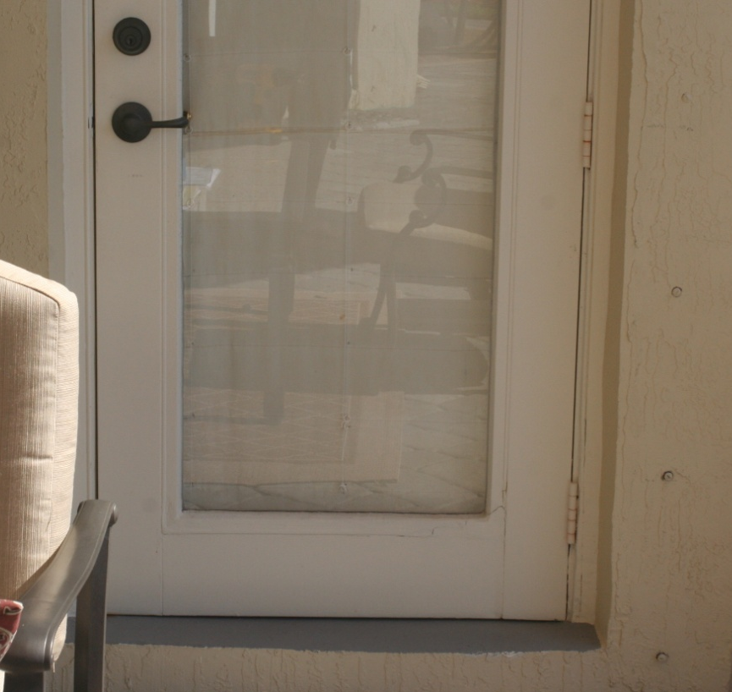

Slide 22
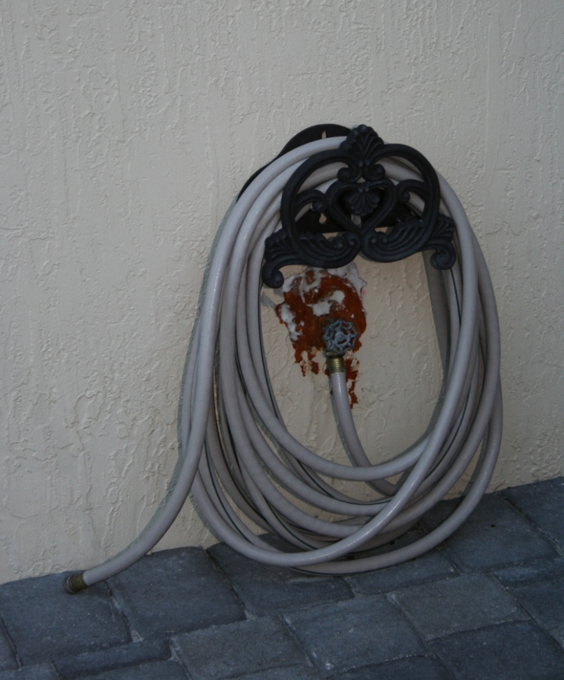


Slide 23
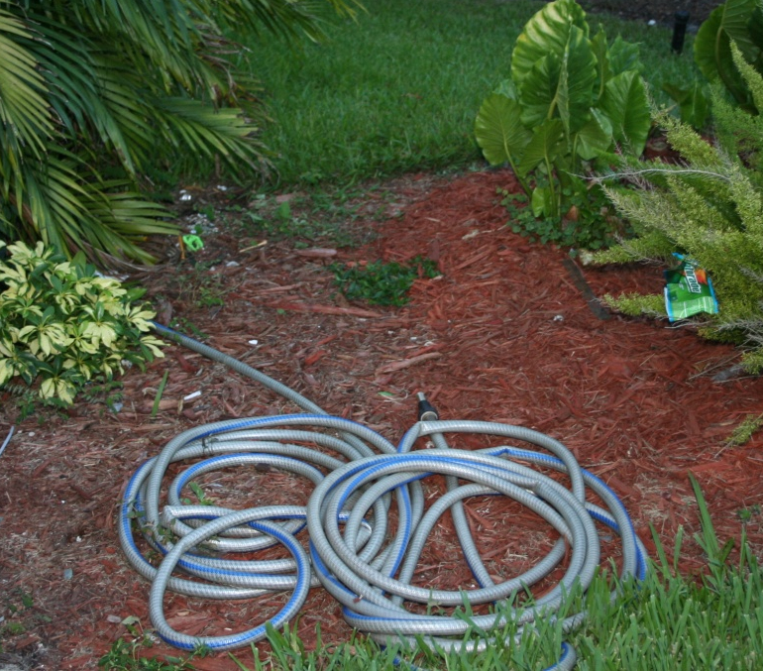
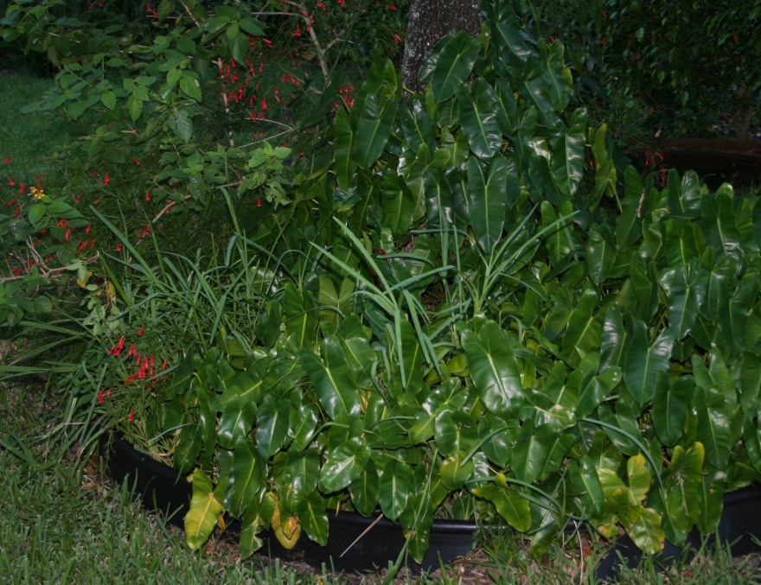

Slide 24
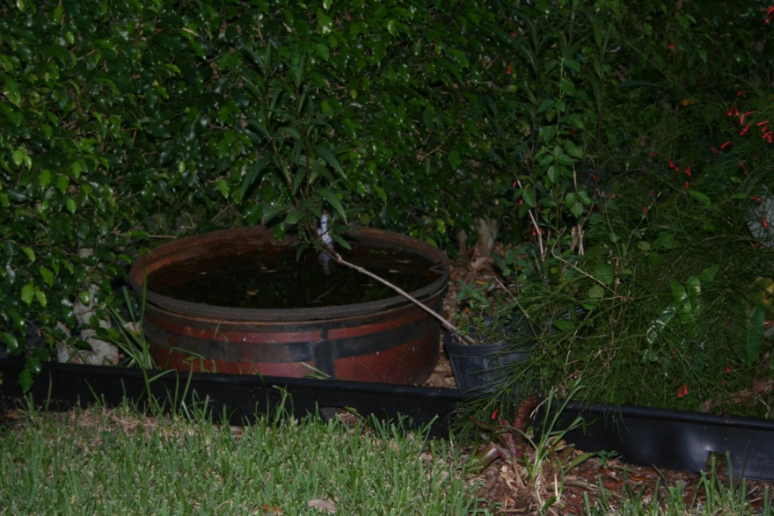
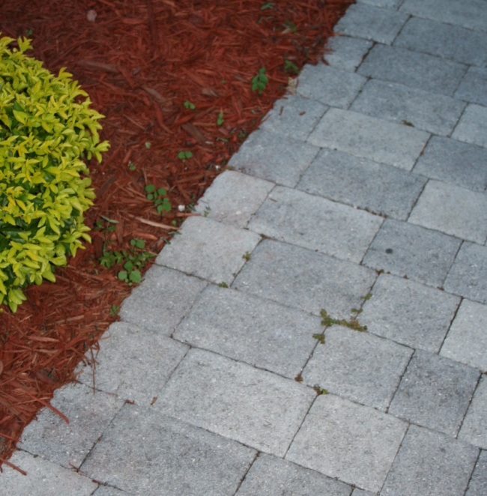

Slide 25
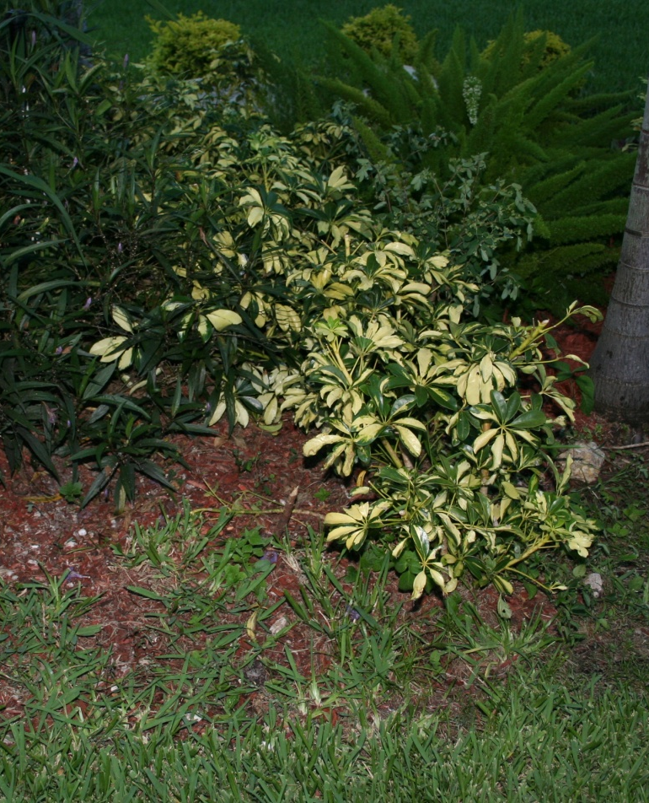


Slide 26
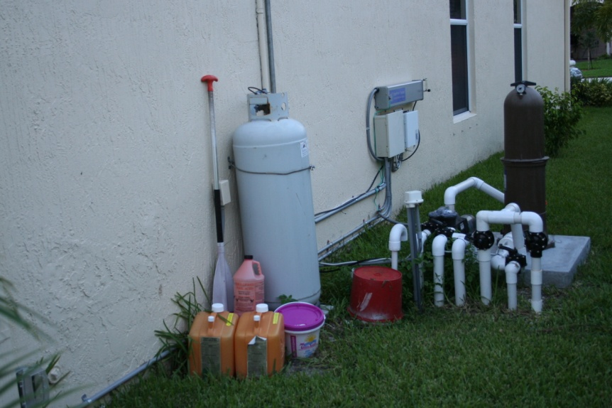
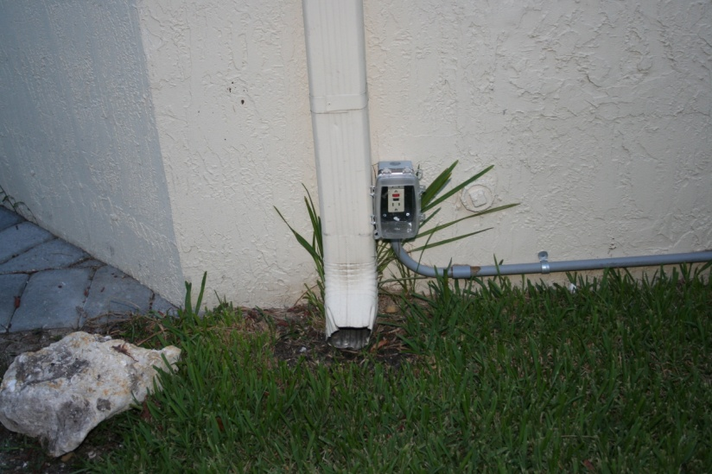

Slide 27
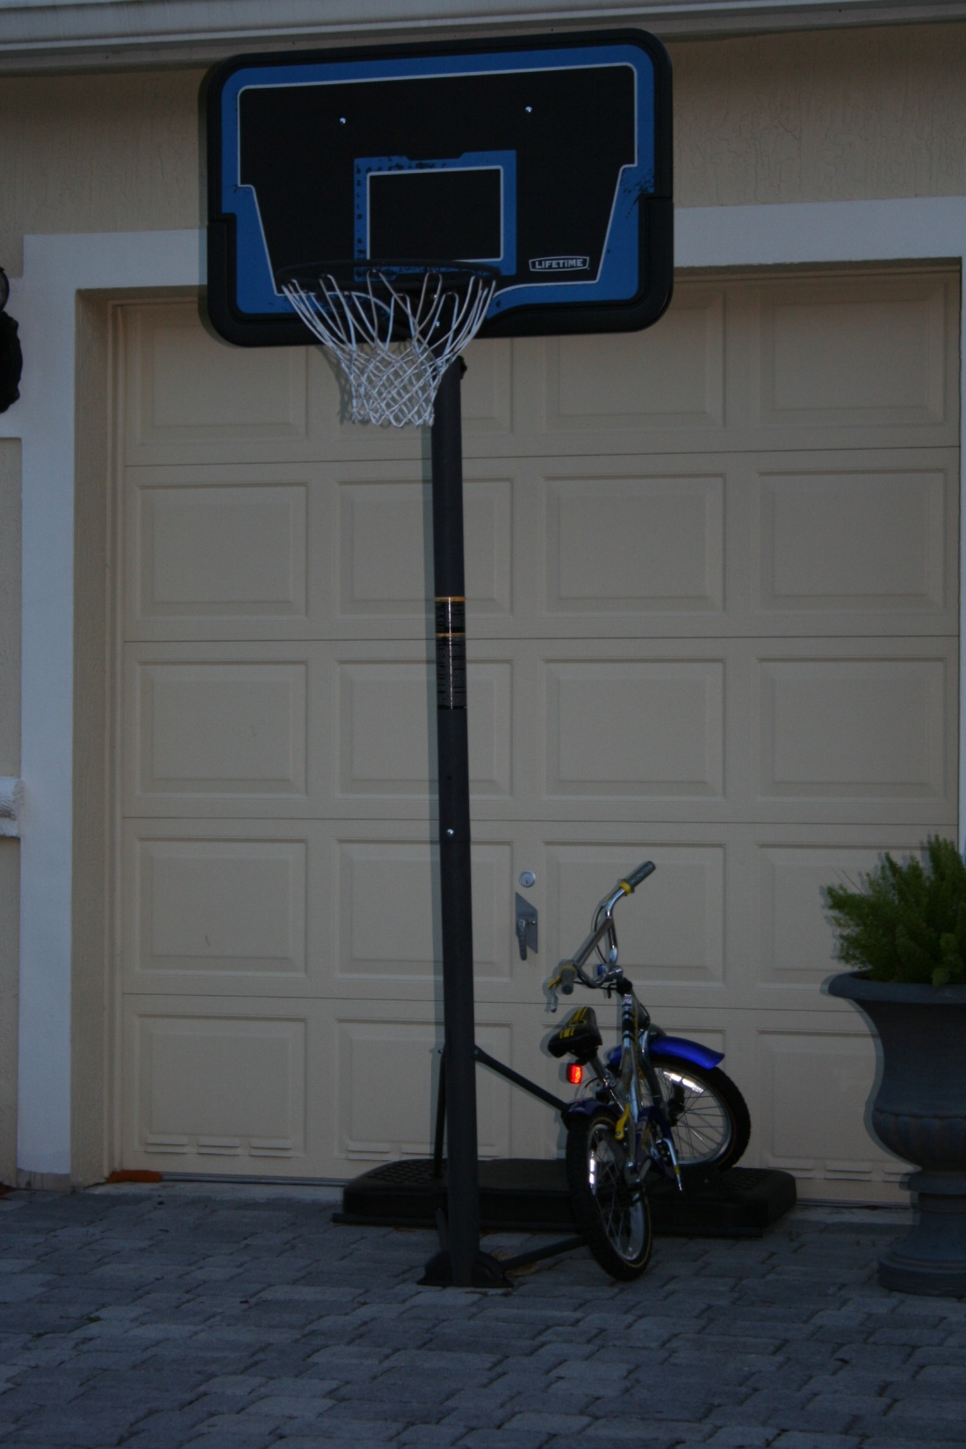

Slide 28
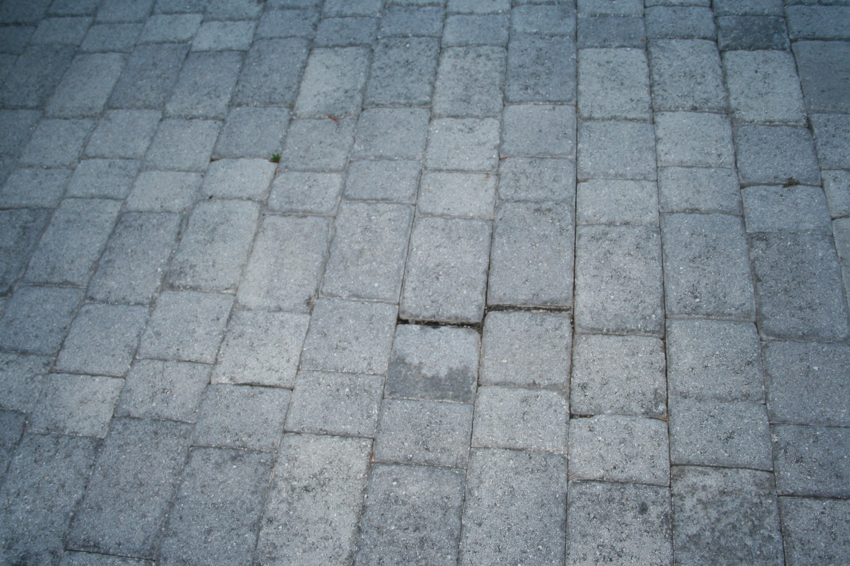

Slide 29
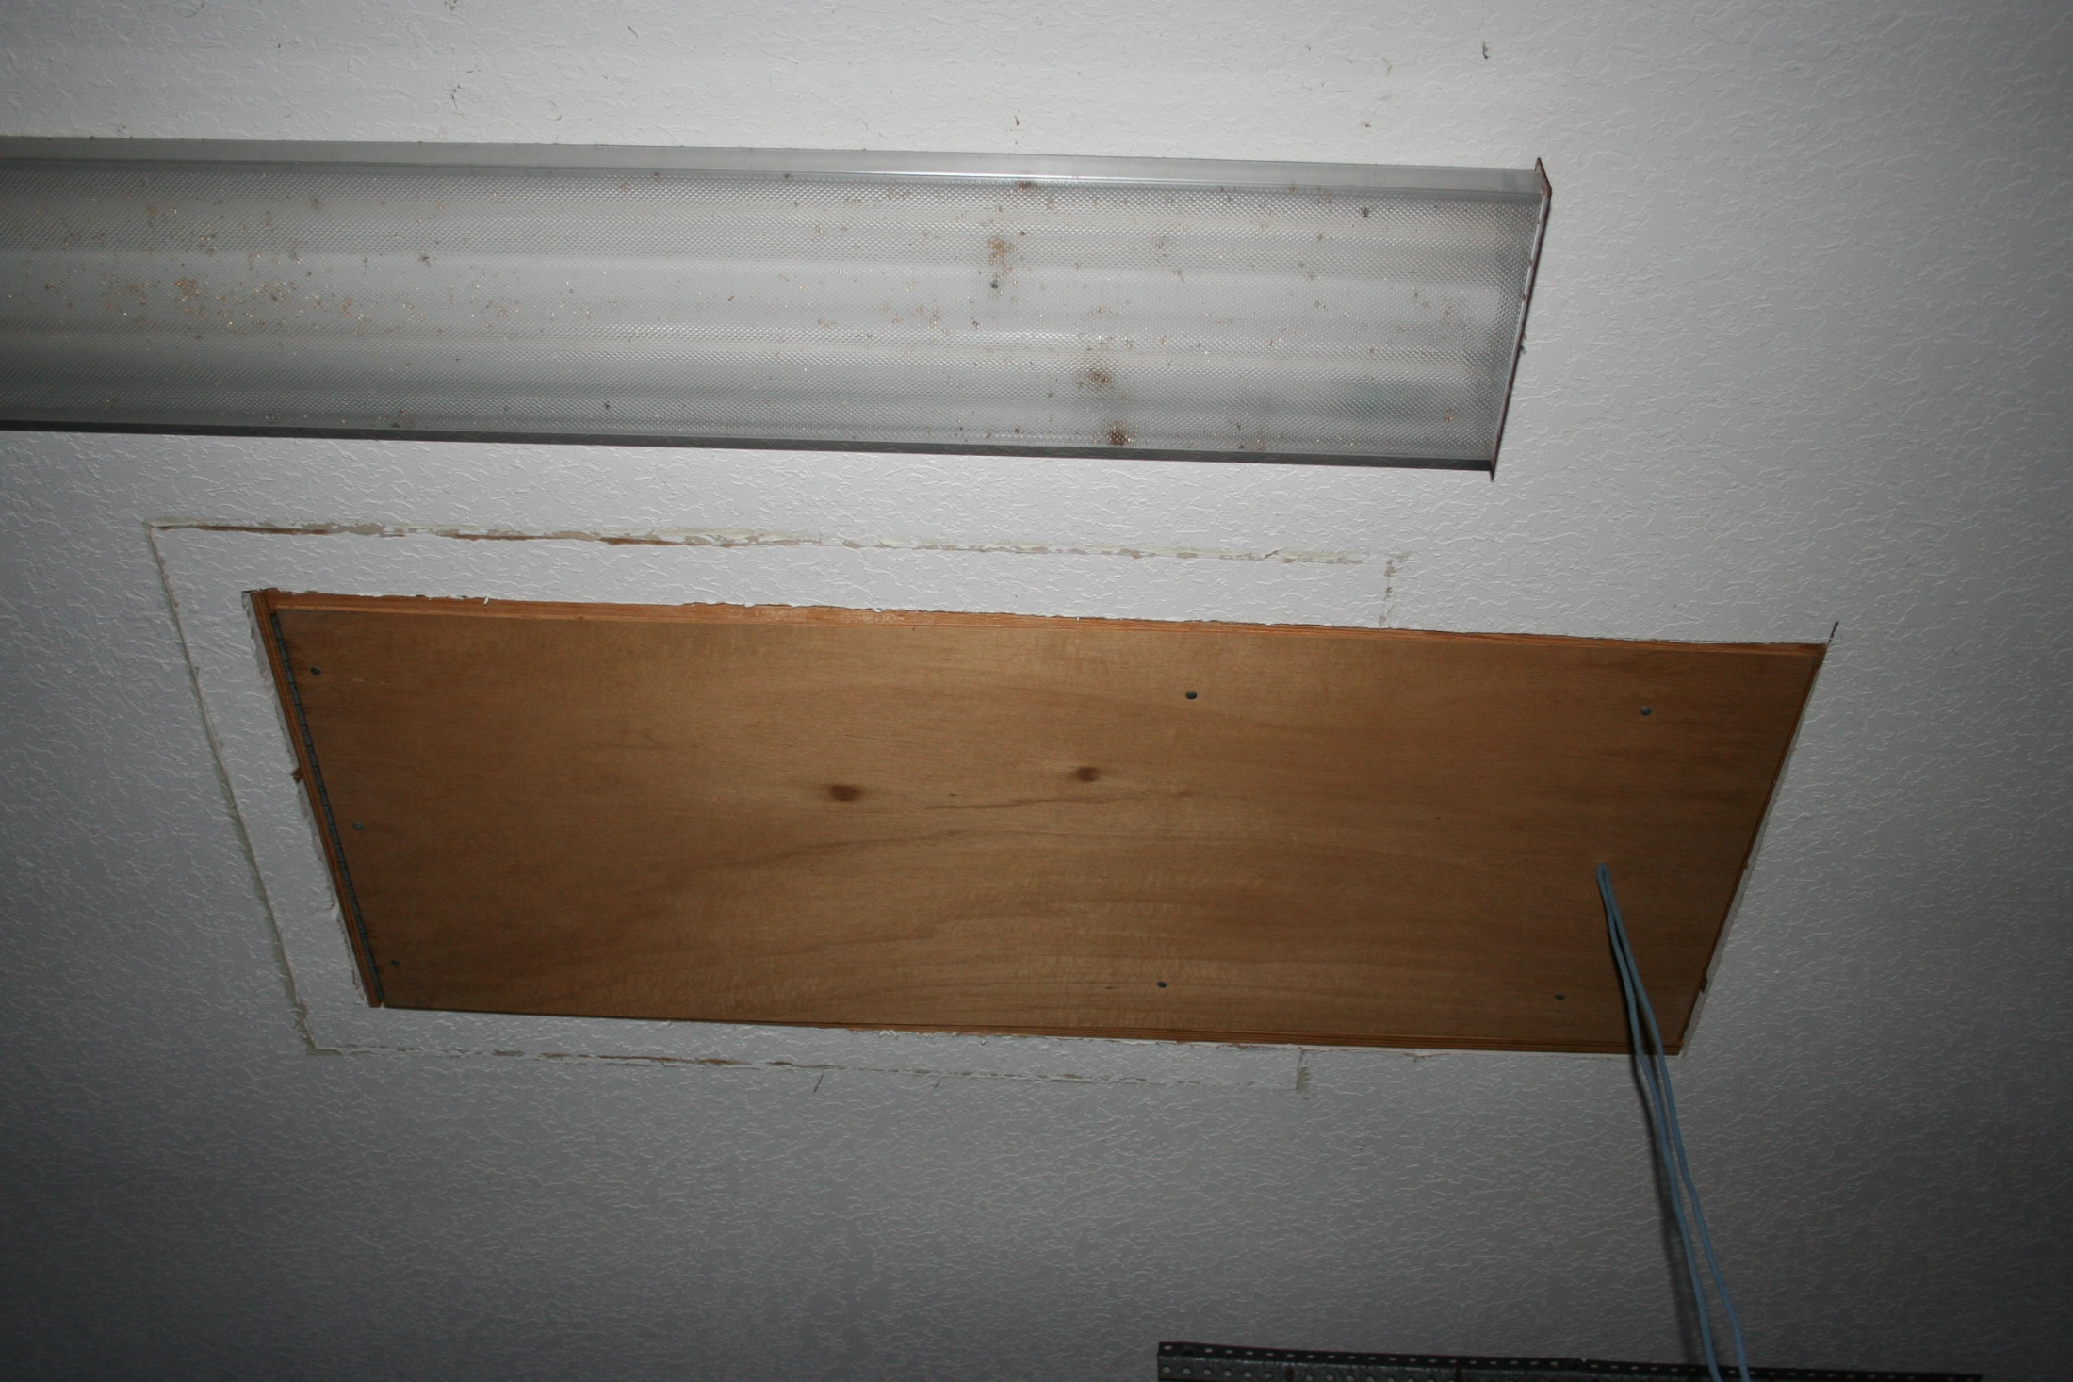

Slide 30
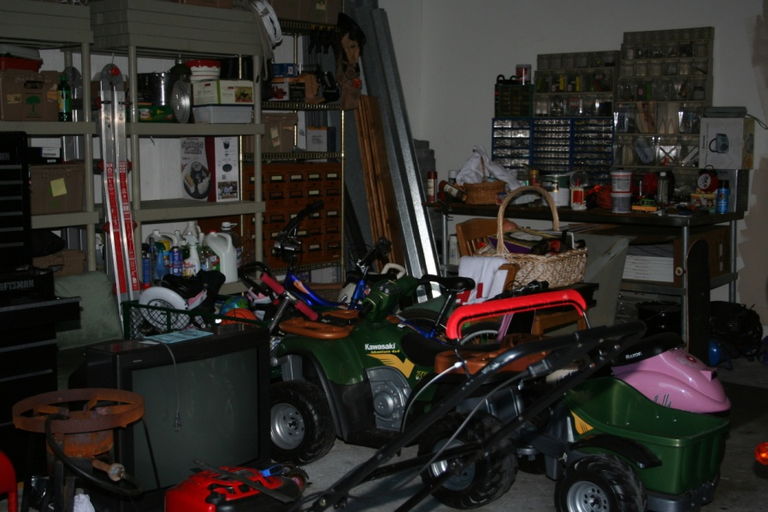
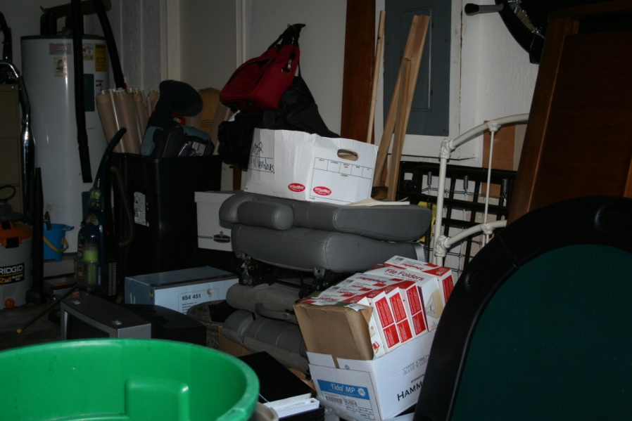

Slide 31
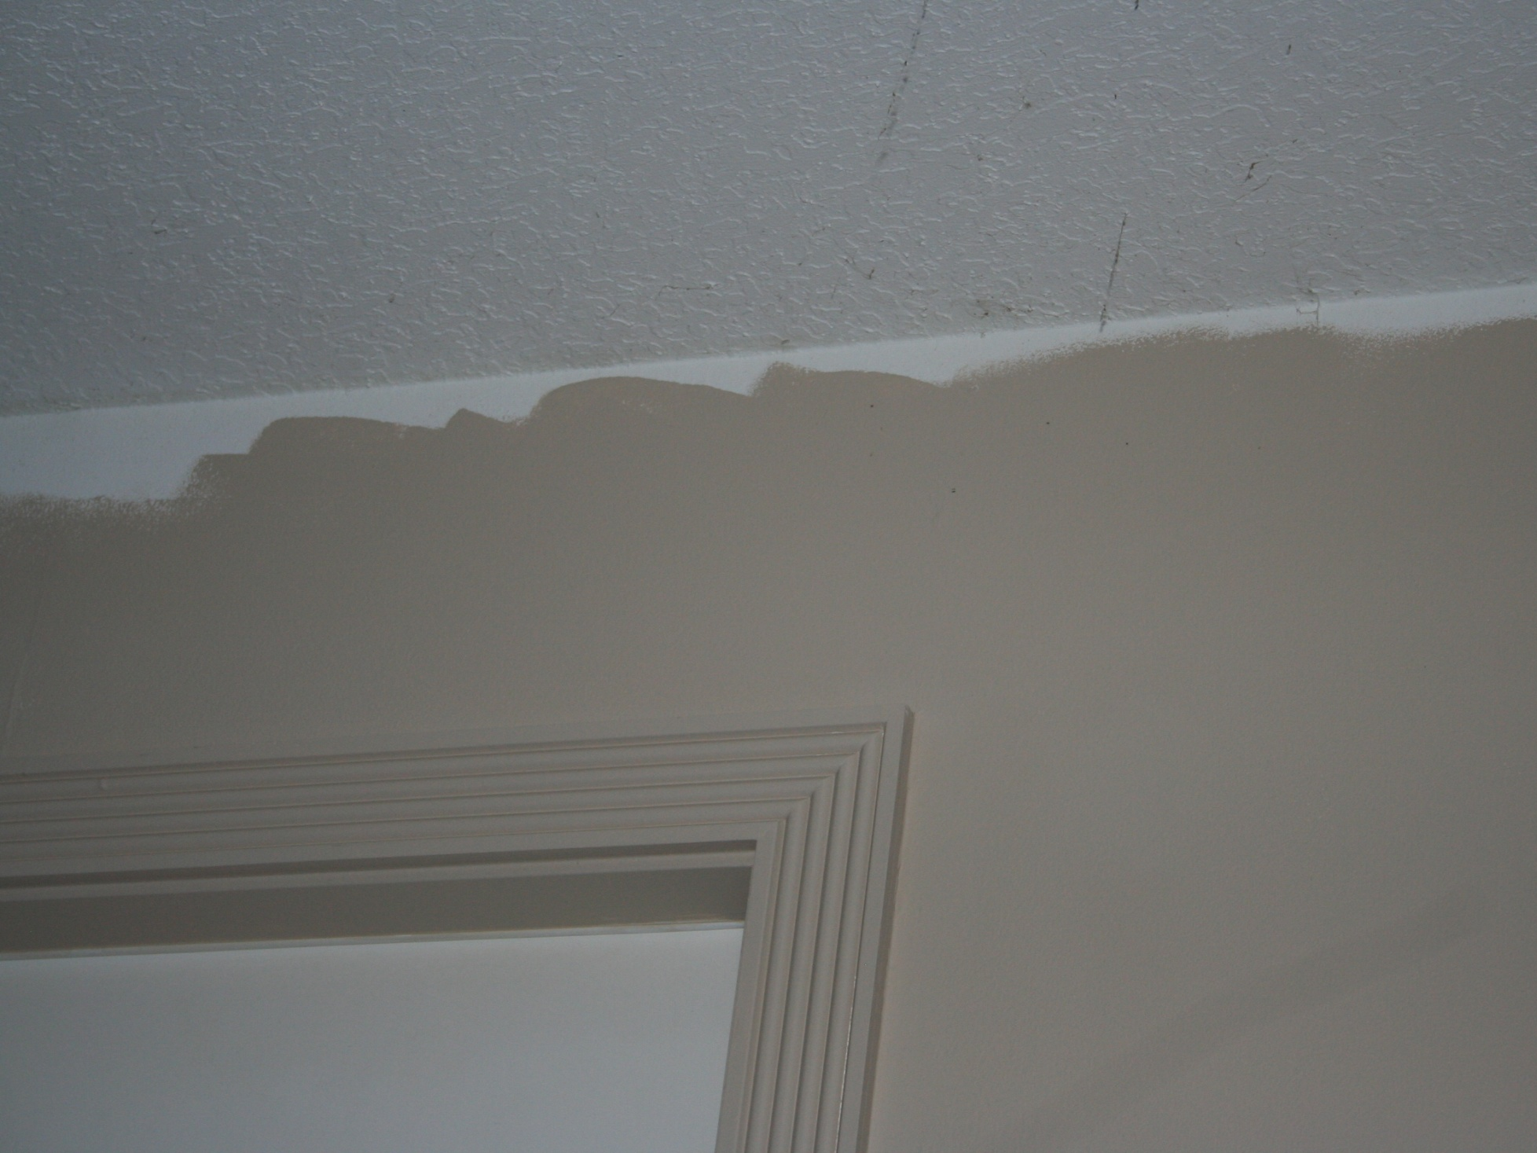
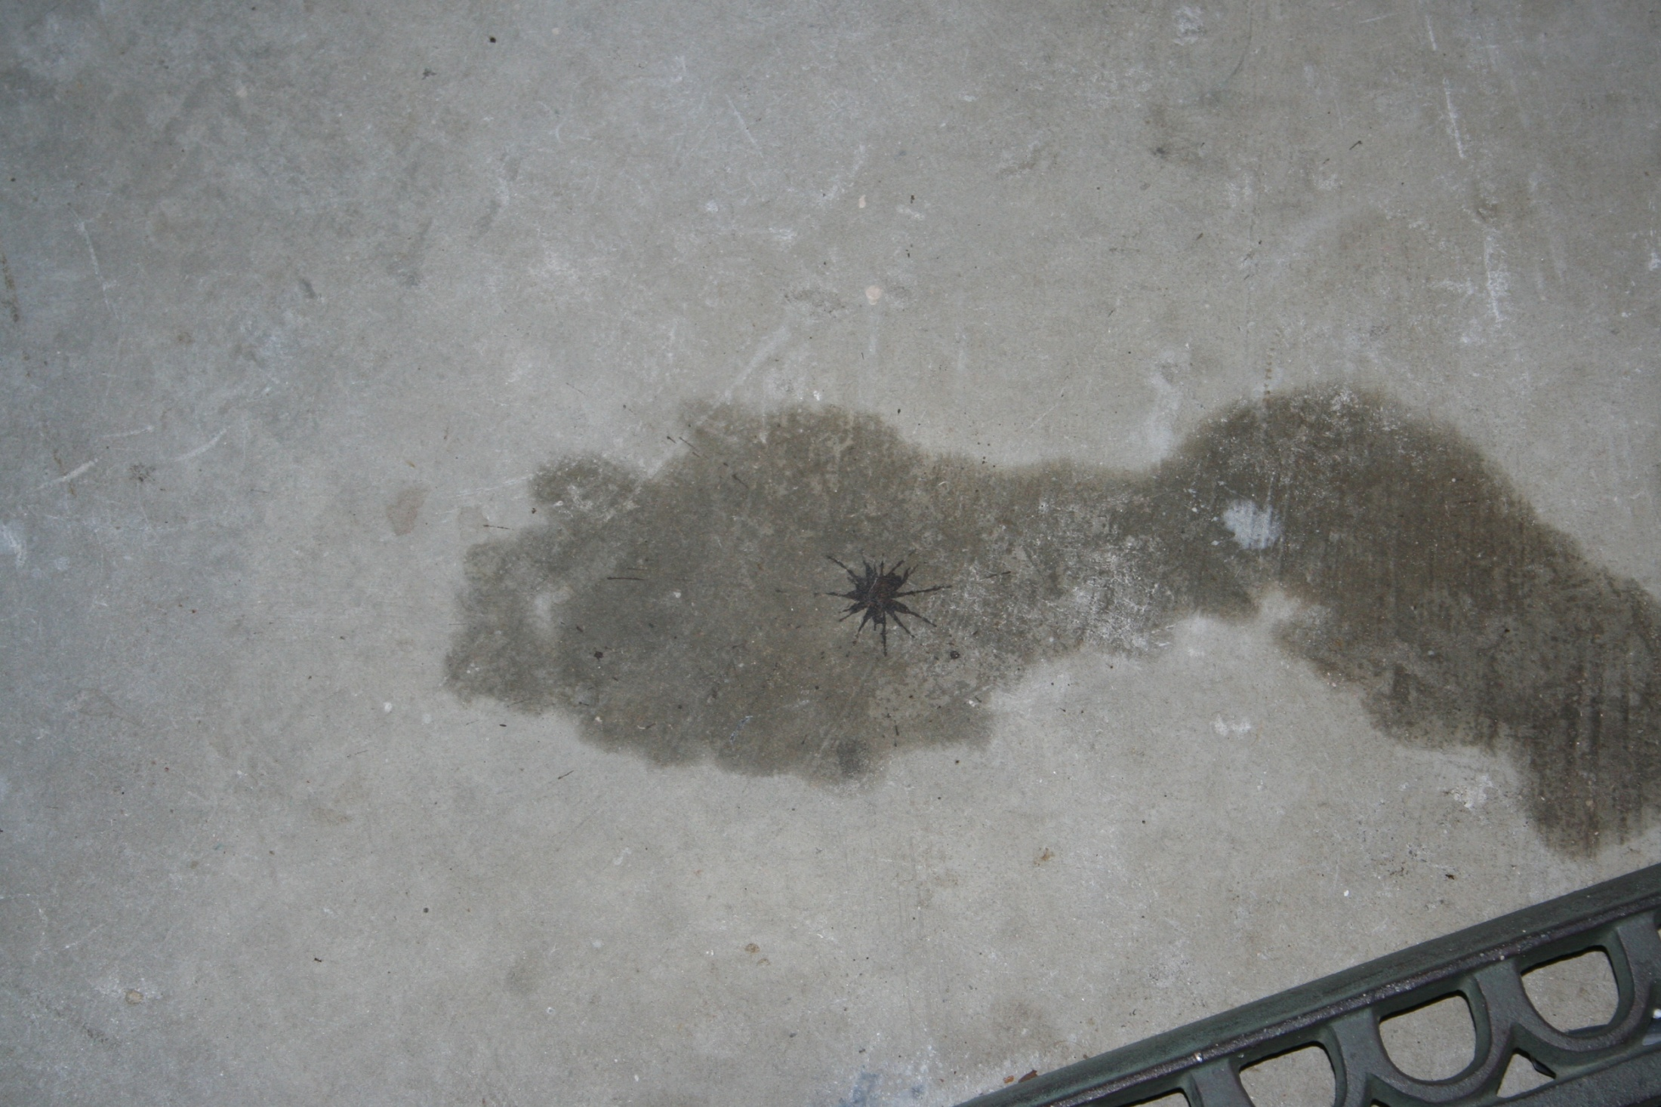

Slide 32
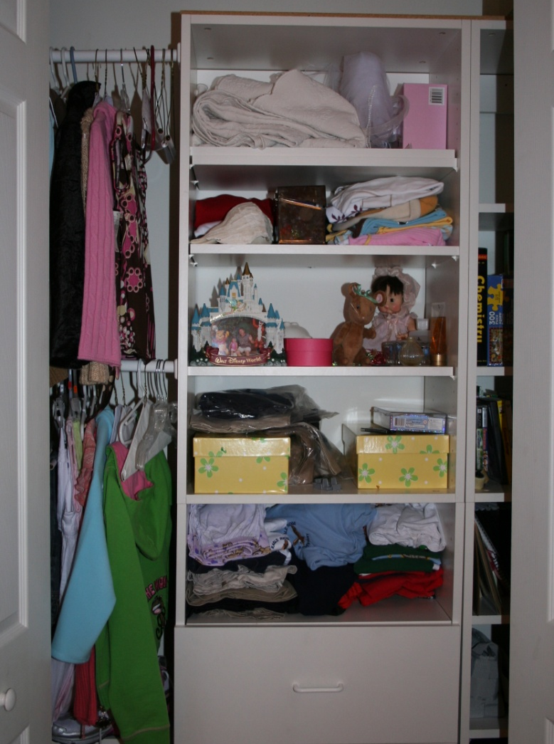
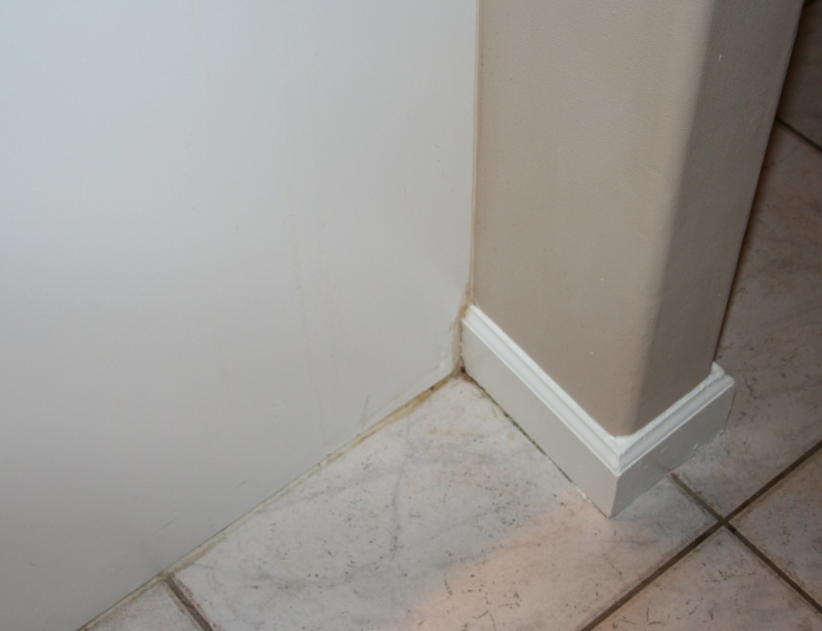

Slide 33
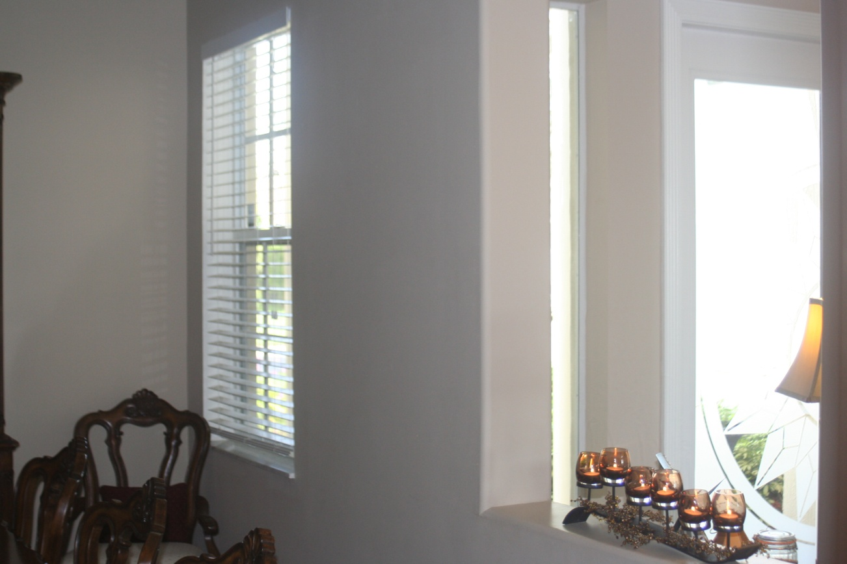
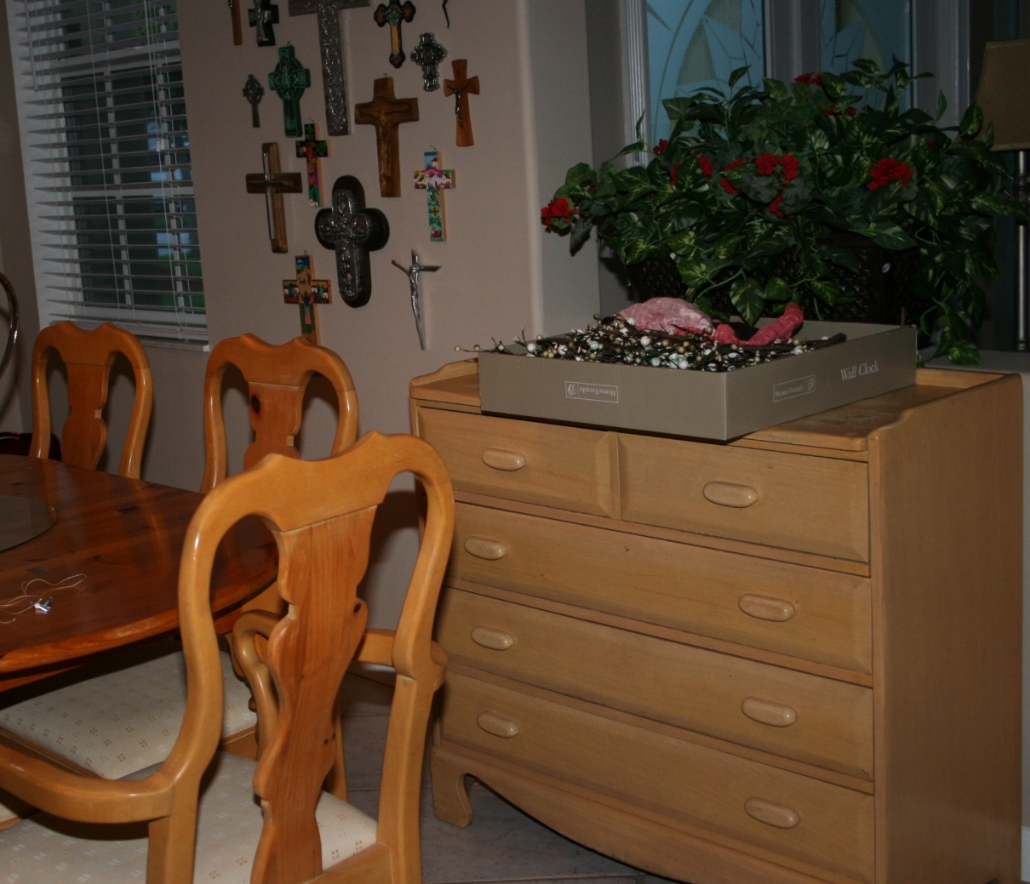

Slide 34
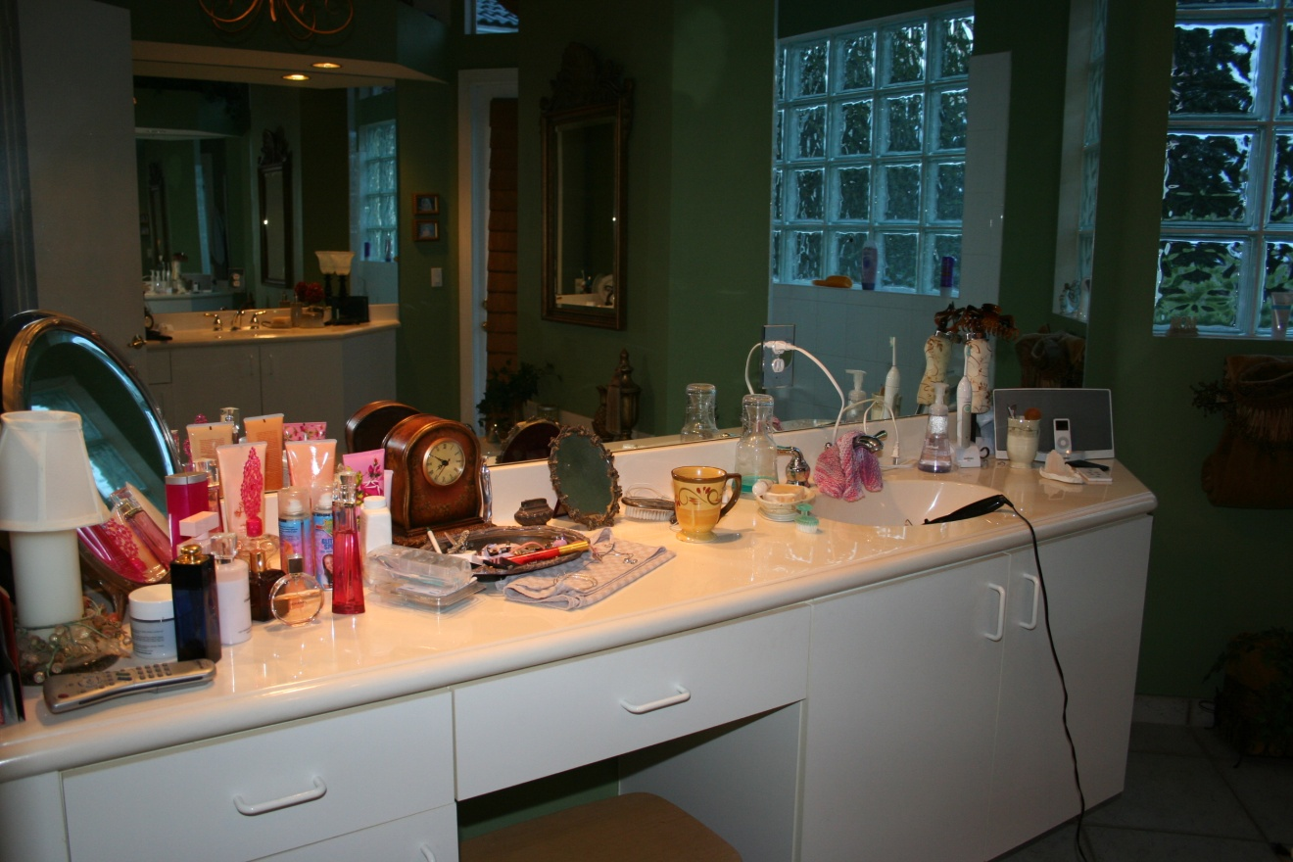

Slide 35
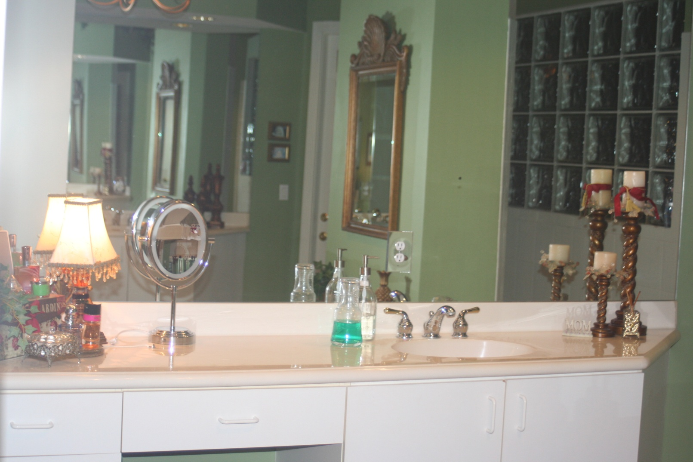

Slide 36
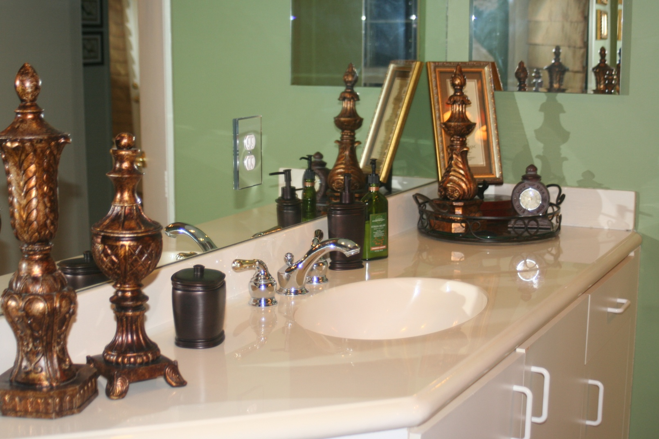

Slide 37
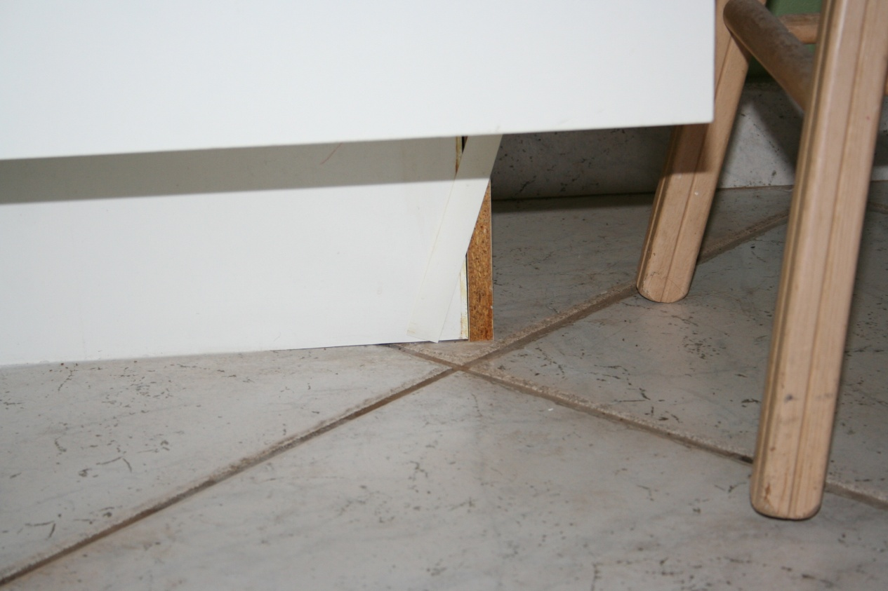

Slide 38
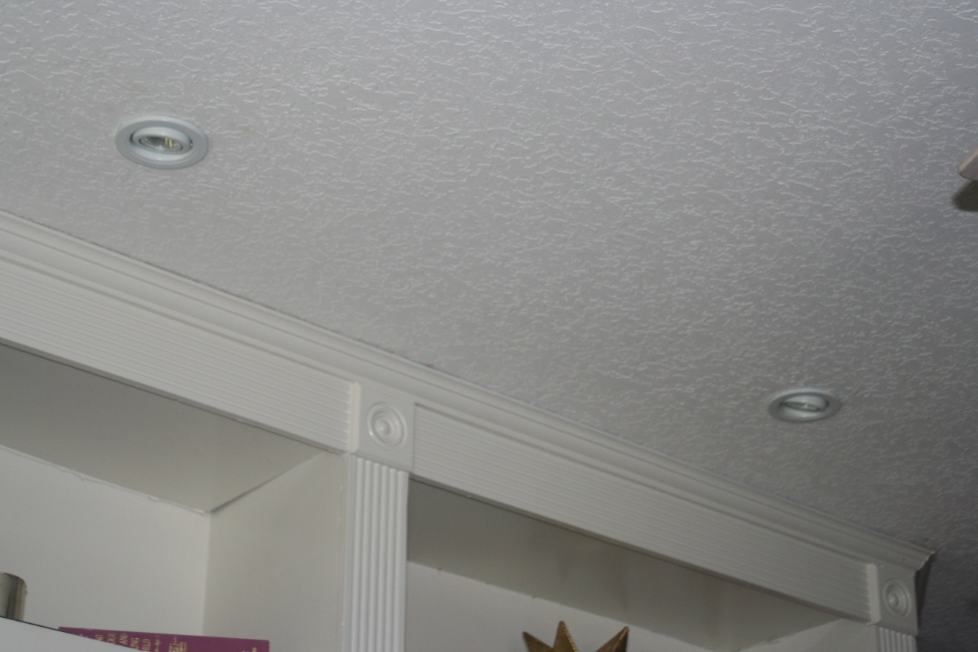
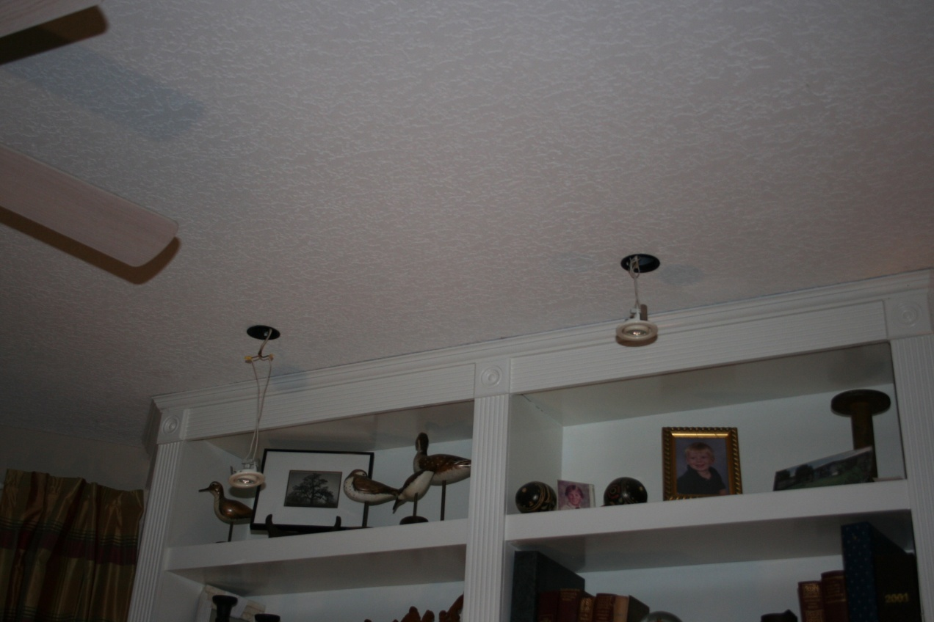

Slide 39
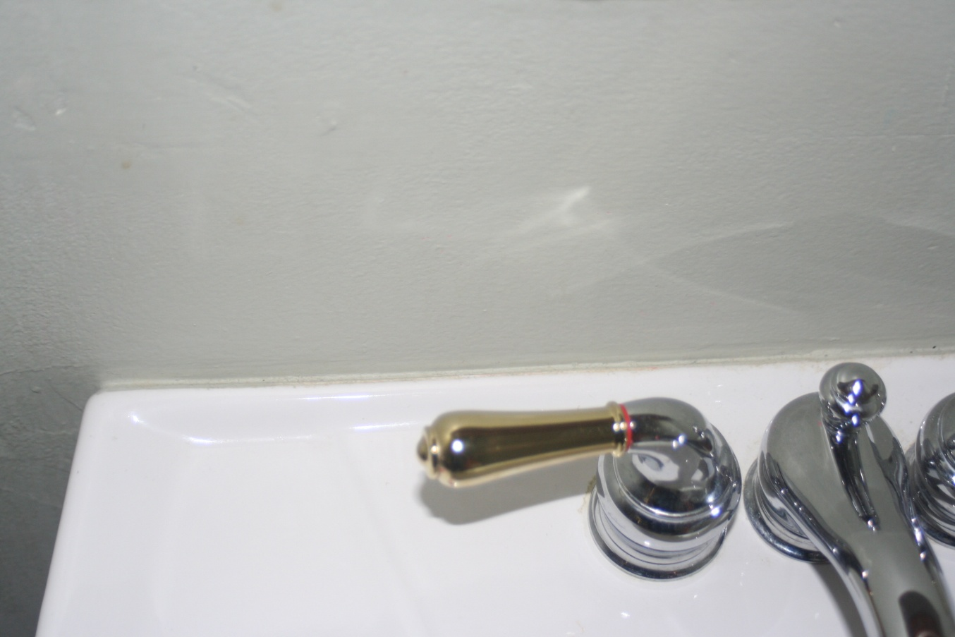
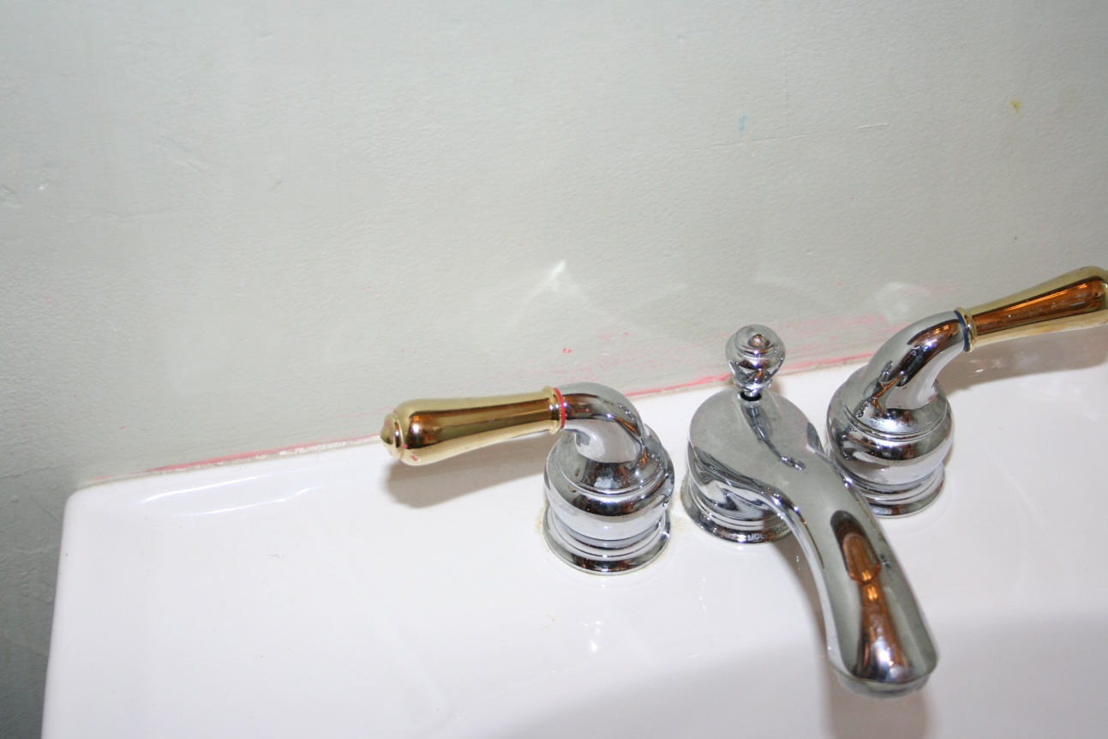

Slide 40
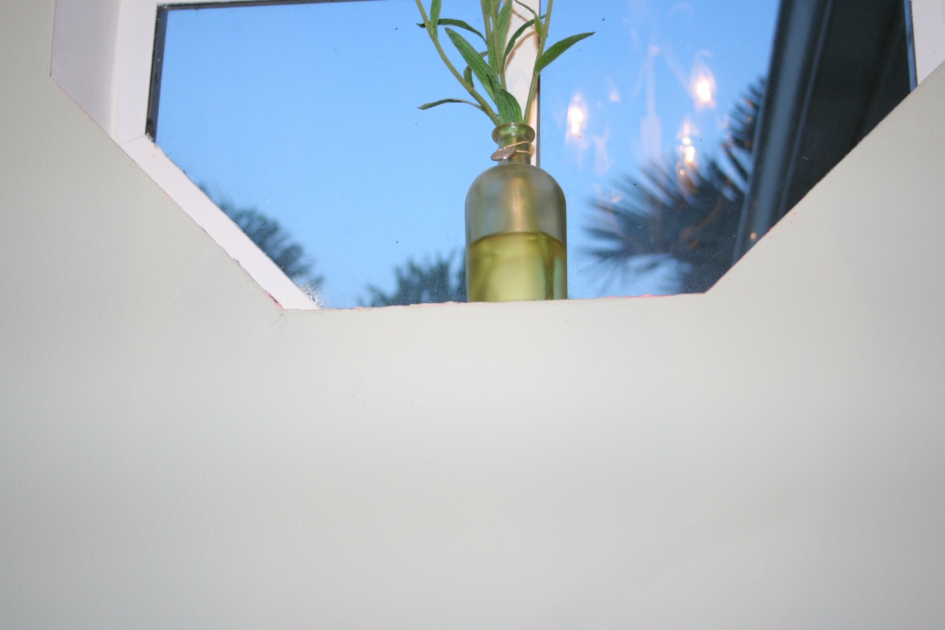

Slide 41
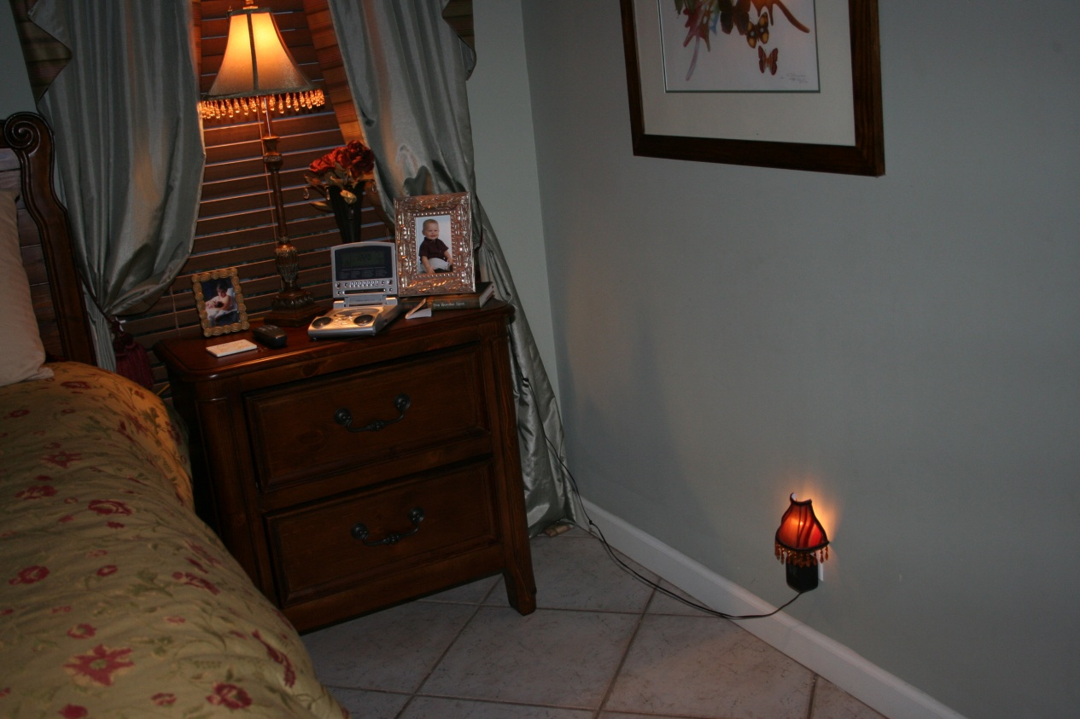

Slide 42
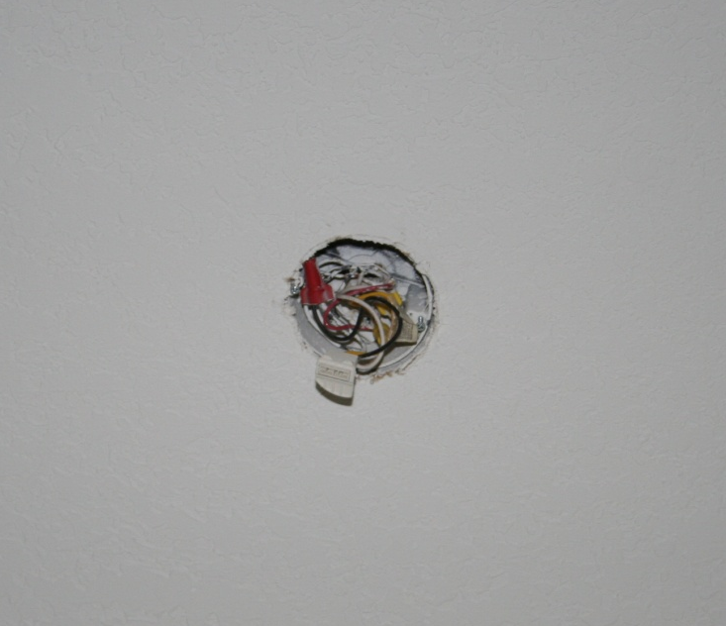
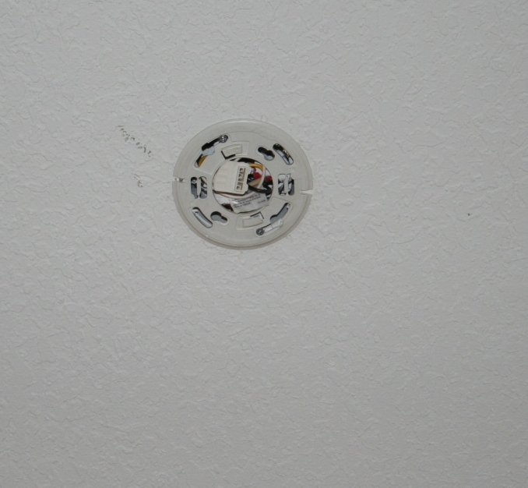

Slide 43
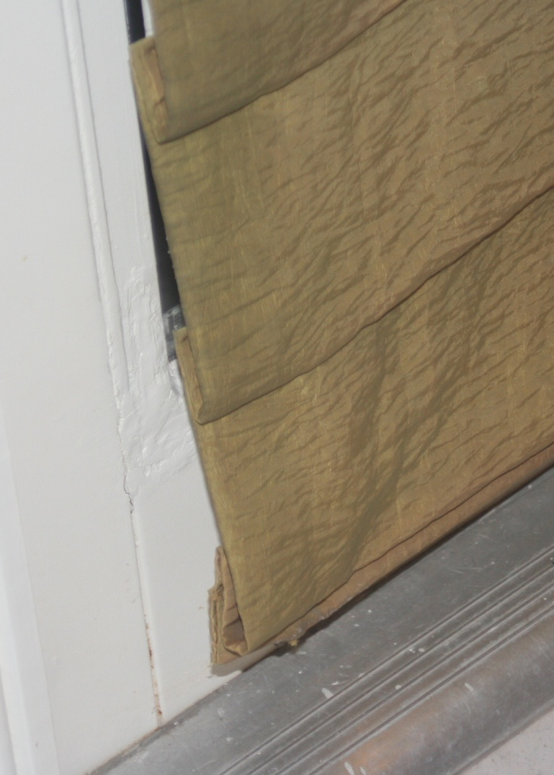
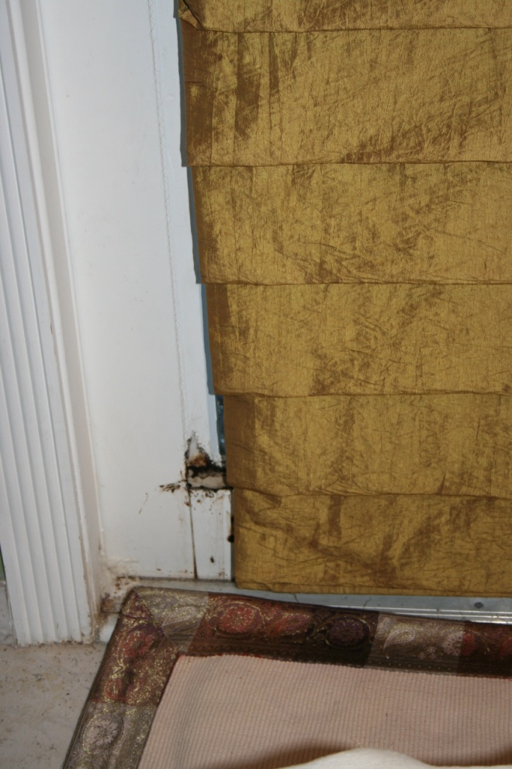

Slide 44
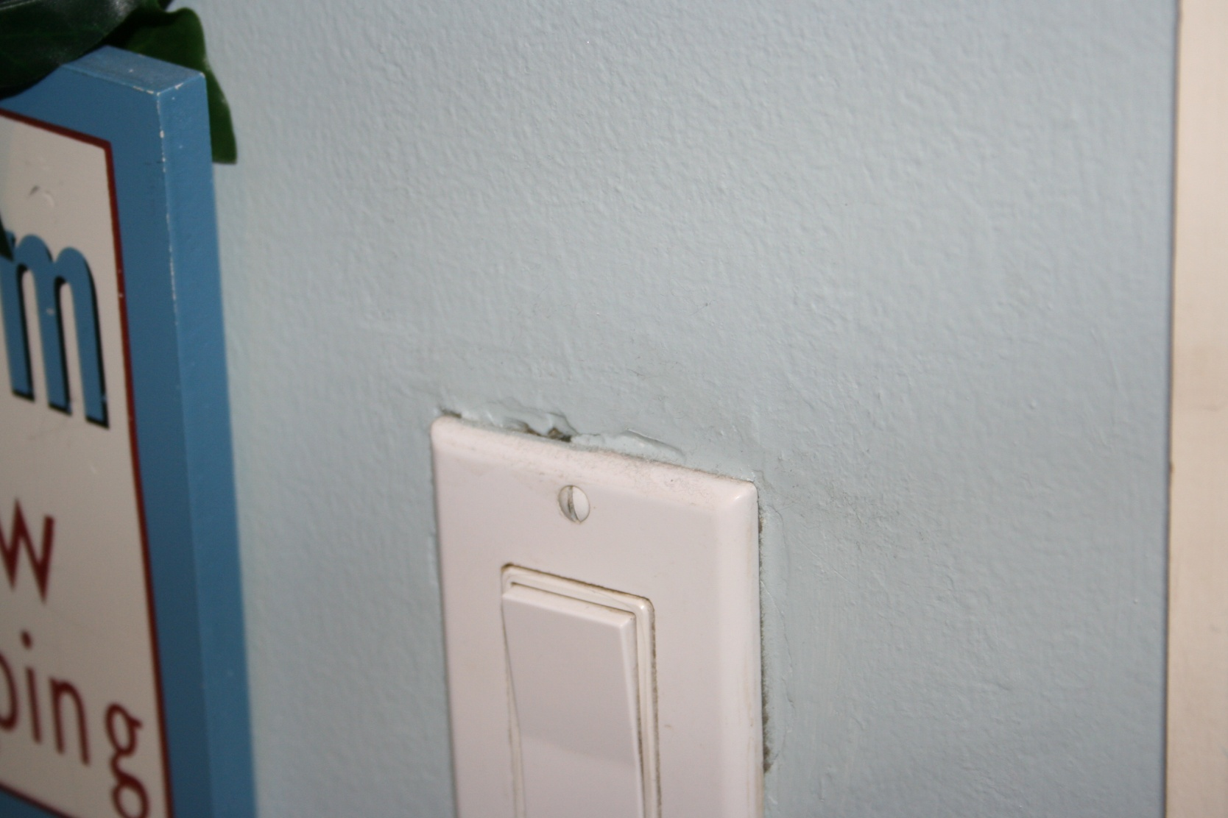
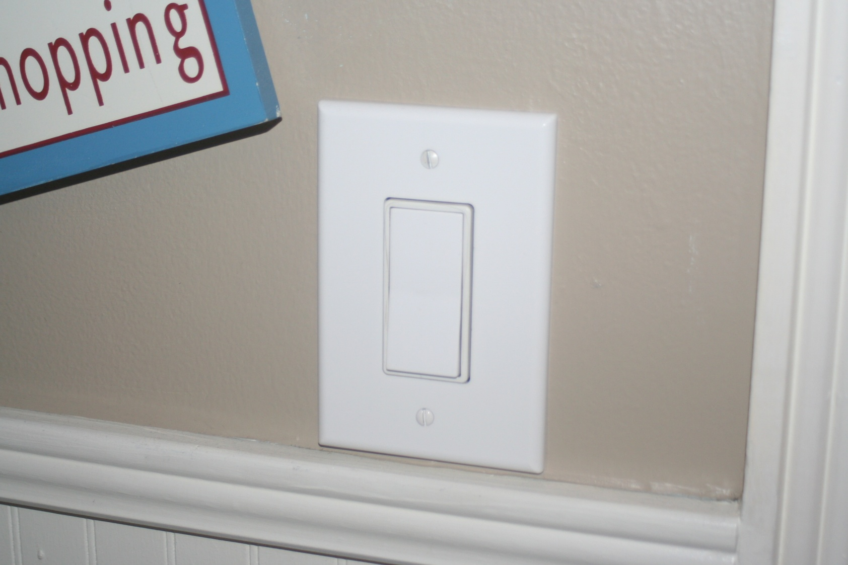

Slide 45
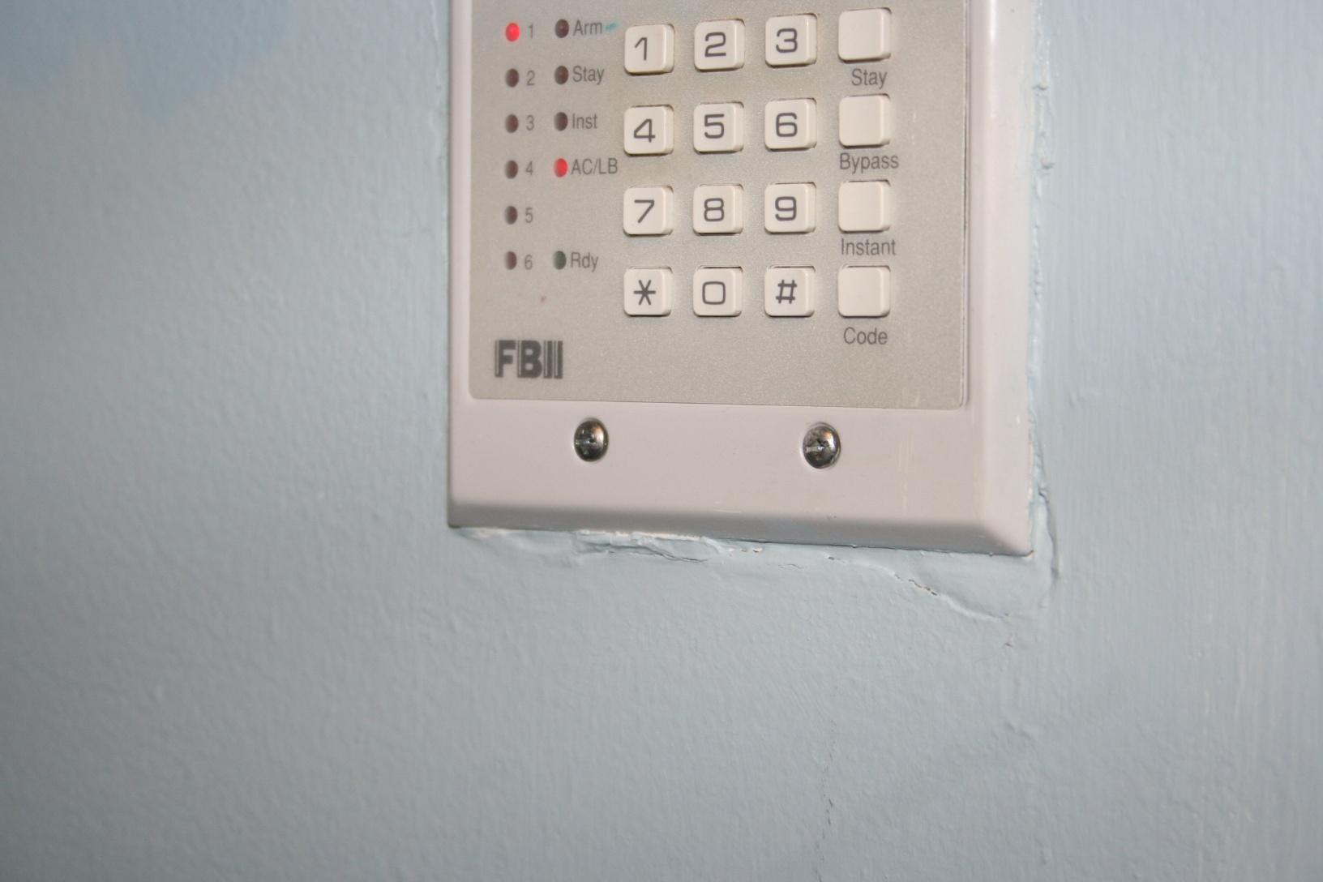

Slide 46


Slide 47


Slide 48


Slide 49


Slide 50


Slide 51


Slide 52


Slide 53


Slide 54


Slide 55



Slide 56


Slide 57


Slide 58


Slide 59


Slide 60


Slide 61


Slide 62


Slide 63


Slide 64


Slide 65


Slide 66


Slide 67



Slide 68


Slide 69


Slide 70


Slide 71


Slide 72



Slide 73



Slide 74



Slide 75


Slide 76




Slide 77


Slide 78


Slide 79


Slide 80


Slide 81



Slide 82


Slide 83


Slide 84


Slide 85


Slide 86


Slide 87


Slide 88


Slide 89


Slide 90


Slide 91


Slide 92


Slide 93


Slide 94


Slide 95


Slide 96


Slide 97


Slide 98


Slide 99


Slide 100


Slide 101


Slide 102


Slide 103


Slide 104


Slide 105


Slide 106


Slide 107





Slide 108


Slide 109
R.E.S.E. Equity Enhancers
Brand New Welcome Mat (at every entrance)
Screen Removal and Spotless Windows
Fresh White Caulk (clear on dark surfaces)
Remove Clutter (Listing décor / less is more)
“Dog less” Showings
Impatiens/Begonias (or other flowering plants)
Fresh Grade A Cypress Mulch (or other)
Wood Rot , Rust (Not if But When, do it now!)
Lighten, Brighten all rooms (open, open, open)
No Smoke (mule team Borax – charcoal bags)

Slide 110
Home Study

Slide 111



Required Materials:
Digital Camera
Active Listing or Friendly Residential Property
R.E.S.E. Home Staging Booklet
go to www.reseworx.com

Slide 112






Slide 113

Simple EZ Common Sense Inexpensive $0 - $100
Clean ~ Declutter ~ De-personalize
Caulk ~ Bleach ~ CLR
Hide Personal Items
Pet ~ Smoke ~ Lighten ~ Brighten ~ Over Crowding
Good Sound Decisions that should be made $100 - $500
Storing Items
Landscaping Opportunites
Minor Paint
Stains ~ Wood Rot ~ Professional Window Cleaning
Best Case Scenario in a perfect world $500+
Marcite
Carpet or Tile
Painting Projects and Wallpaper
More Major Concerns

Slide 114

Assignment:
Take photographs of every staging recommendation
DO NOT PERFORM ACTUAL STAGING ACTIVITY
Make specific notation to each recommendation
Submit booklet, notes, digital photographs
Be sure to include your PRIORITIZED RECOMMENDATIONS and BUDGET CONCERNS.
service@anniemacworx.com

Slide 115

www.reseworx.com

Slide 116
Advanced Staging
Beyond RESE
Victoria Guillot, CSS/CRS
“The Stage Coach”
Stage Coach Services LLC

Slide 117


Slide 118



Slide 119
Brought to you by…

